Slide 1

Enterprise-scale landing zones Getting ready to deploy workloads on Azure
Speaker
Title

Slide 2
Agenda
● Azure landing zones
● What is Enterprise-scale?
● Enterprise-scale Design Principles
● Enterprise-scale Design Guidelines
● Enterprise-scale Implementation Guide
● Enterprise-scale Reference Implementations
● Resources & Next Steps
Notes:
Key message – in this session we are going to cover a key element in your cloud journey and critical step to successfully deploy workloads on Azure.

Slide 3
Azure landing zones
Notes:
Building on how cloud operating models define how cloud environments are used, lets now look at how we define the foundations of those environments with landing zones.
Azure landing zones are a key element of a successful cloud adoption journey as they establish the platform components that help organizations safely, and successfully migrate and innovate in the cloud.

Slide 4

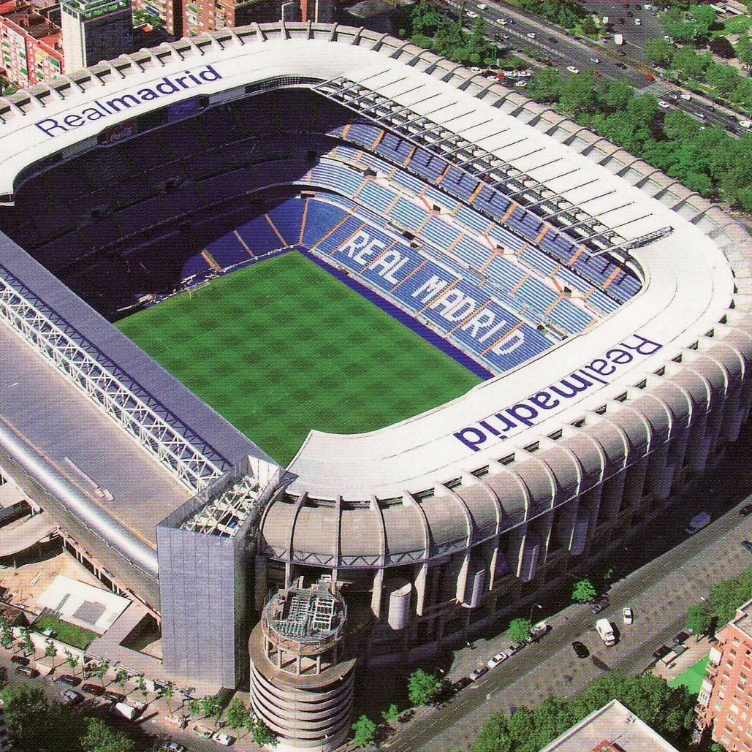

What are you building? Your cloud foundation supports the construction of a—
House
Stadium
Bridge
Notes:
Building a cloud environment like constructing a building—a house, stadium, or bridge.
The structure you’re going to build will determine your approach and architectural style.
Depending on the structure, the foundations may vary.
However, there will be common items across the various foundations.
This is also true in the cloud.
The cloud foundations may vary depending on your requirements, or the scale you need for your environment
but just like construction foundations will start with concrete and steel, cloud environments will also share common starting elements.
Which is where a landing zone comes. Let's look at what purpose they serve.

Slide 5
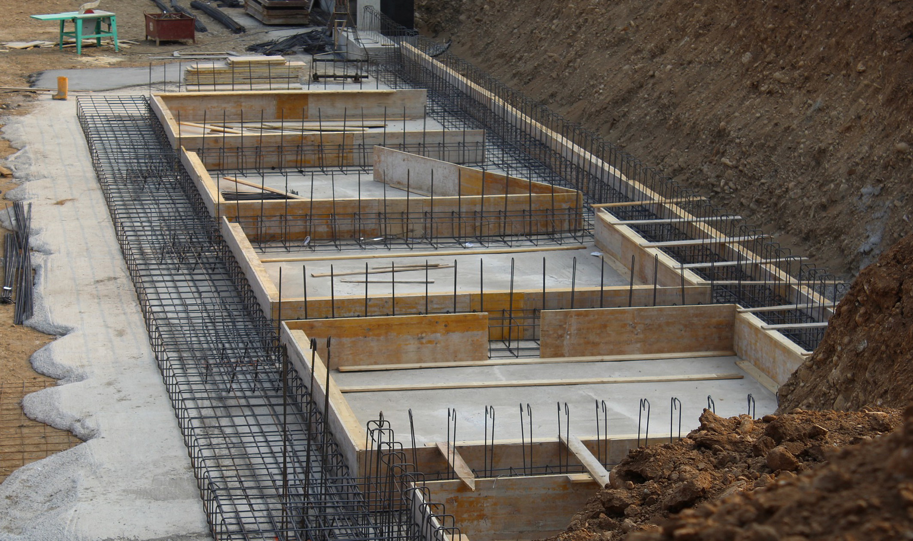
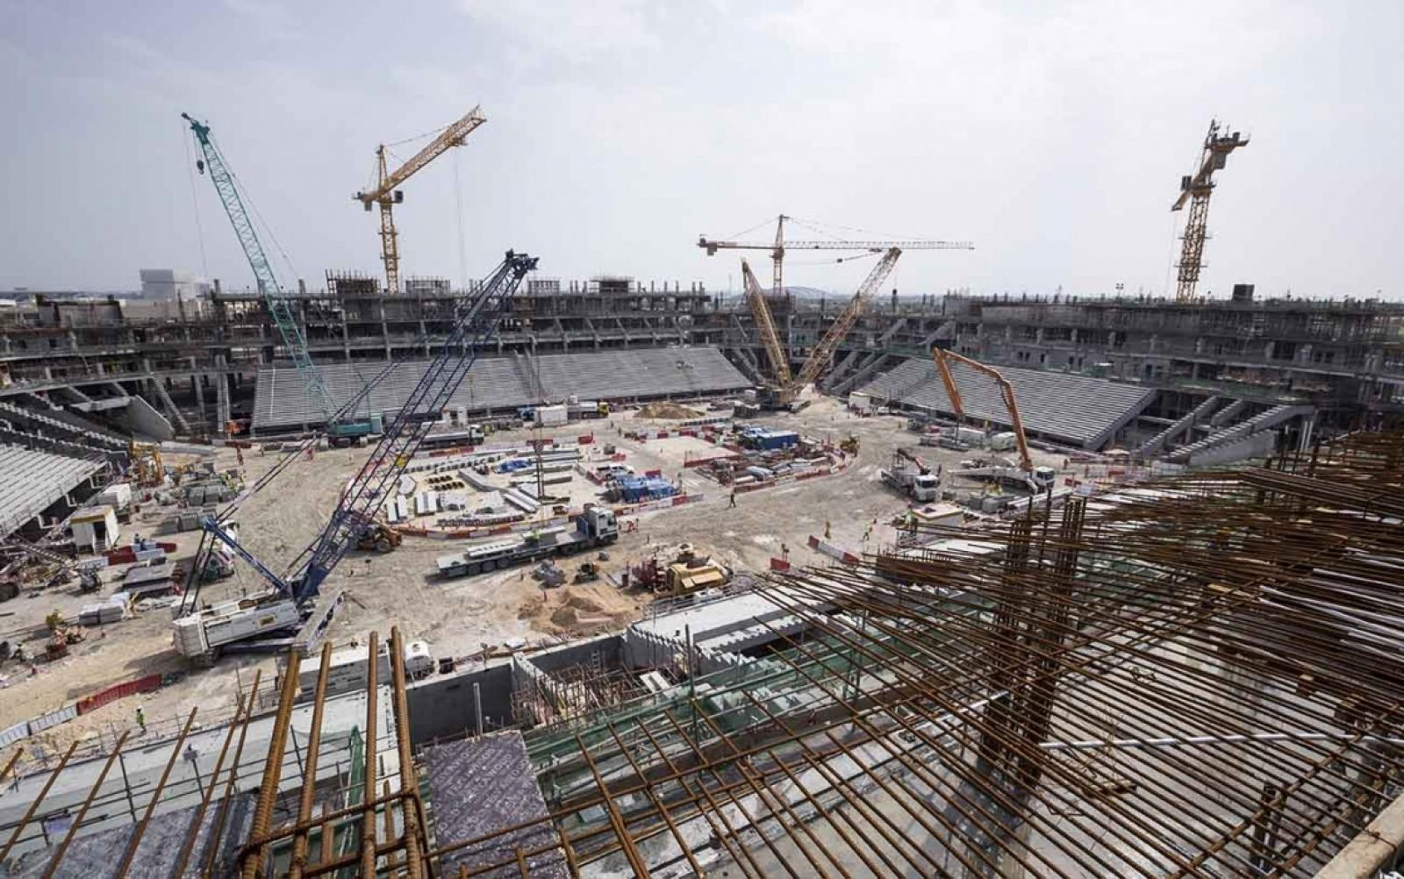
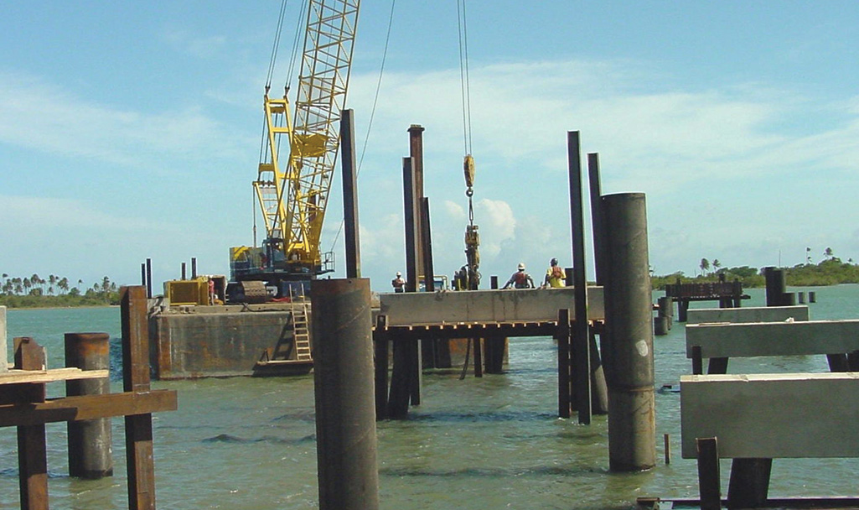
All foundations are NOT created equal
A house
A stadium
A bridge
Notes:
<Key point>: The foundation selection depends on what you’re building.
Foundations will be tailored to the construction of what’s being built above it.
<Transition>: Choosing the right structural foundation is like choosing the right cloud foundation.

Slide 6
What are landing zones for?
Starting a journey based on best practices with a start-to-finish plan is a key factor for success
Creating well-designed foundations for a cloud environment will enable the safe adoption of new technologies, at pace
Using consistent, repeatable environment designs helps scaling out in a manageable way
Baking in repeatable best practices into environment deployments
Factoring your team's technical skills into environment planning
Notes:
A landing zone is intended to help start an environment build from strong foundations.
Best practices
Repeatable to ensure standardization
Consider technical skills of the team and their learning plans as part of the decisions you take in planning your landing zone.
Let's look at the benefits landing zones can provide for your organization.

Slide 7
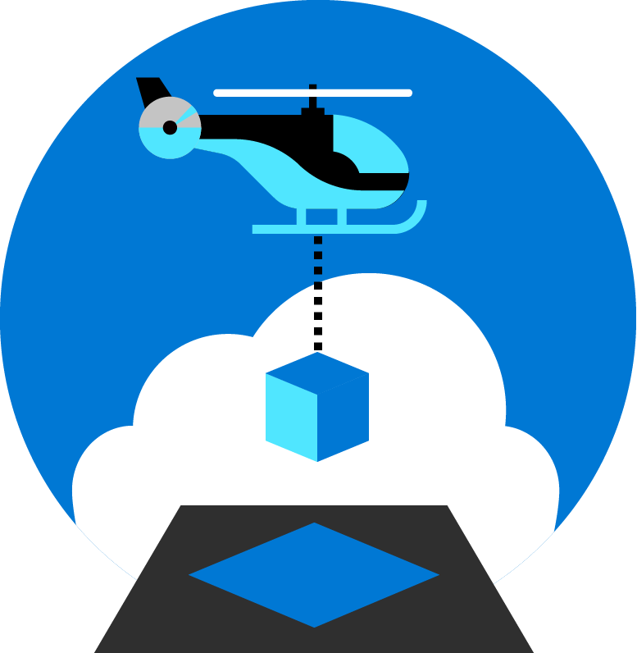
Azure landing zones
Set up Azure environments— for scale, security, governance, networking, and identity
Enable migrations and net new apps
Consider all platform resources
Don't differentiate between IaaS or PaaS
Notes:
Azure landing zones focus on unifying technologies and technical guidance to help you build a successful cloud environment.
In general, Azure landing zones:
Offer repeatable packaged environments
Enable migrations and net new apps.
Simplify the process of starting a cloud environment, to enable teams to focus on migration or innovation
Now, lets look in detail at what we consider to be the focus areas for a landing zone.

Slide 8

Azure landing zones Design areas
Azure billing & Azure Active Directory tenant
Security
Identity & access management
Governance
ENVIRONMENT
COMPLIANCE
Resource organization
Management
Network topology & connectivity
Platform automation & DevOps
Notes:
Design areas (the different parts that make up Azure landing zones) are an important early step in thinking about and designing a landing zone.
Azure billing an Active Directory tenant - Proper tenant creation, enrolment, and billing setup are important early steps.
Identity and access management - Identity and access management is a primary security boundary in the public cloud. It's the foundation for any secure and fully compliant architecture.
Resource organization - As cloud adoption scales, considerations for subscription design and management group hierarchy have an impact on governance, operations management, and adoption patterns.
Network topology and connectivity - Networking and connectivity decisions are an equally important foundational aspect of any cloud architecture.
Security - Implement controls and process to protect your cloud environments
Governance - Automate auditing and enforcement of governance policies.
Management - For stable, ongoing operations in the cloud, a management baseline is required to provide visibility, operations compliance, and protect and recover capabilities.
Platform automation and DevOps - Align the best tools and templates to deploy your landing zones and supporting resources.
Split into Environment and Compliance:
Build vs Run
Starting points vs on-going iterations and refinements
Let's look at how we approach an understanding of how a cloud operating model works.

Slide 9
What is Enterprise-scale?

Slide 10



Key Challenges
Architecture Complexity: Customers lack the required level of understanding and experience on Azure. The mismatch between on-premises infrastructure and cloud-design considerations creates dissonance and friction with respect to defining architectures and standards for their migration to the cloud. They are struggling with the translation of their requirements to Azure concepts, capabilities, constructs and security model.
Operating Compatibility: Existing approaches and functions for the traditional delivery and management of IT services are not compatible with the Azure platform and cloud operating models. When combined with a lack of skills and experience, customers are struggling to define and therefore transform their operating model to manage and support large-scale cloud infrastructure.
Lack of Trust and Desire for Control: The absence of a precise and detailed cloud architecture that is compliant with their requirements, and the lack of a well-defined operating model to support such a platform, leads IT not to trust Azure and instead strive to maintain full control. This often involves building ‘walls’ and complicated processes which ultimately get in the way of business lines adopting Azure.
Notes:
In working with our customers and partners we have received feedback from some of the challenges they face. When starting with Azure but being accustomed to Traditional IT Architecture the Cloud model can get lost in translation between Technology concepts, security models, and IT management processes. On top of the architectural challenges there are challenges with operating models. Traditional delivery and management of IT services is not compatible with cloud operating models. Lastly our Customers and partners have a desire for Control of their could environment and precise and compliant platform that generates trust.

Slide 11

Metropolis
Using an analogy, this is similar to how city utilities such as water, gas, and electricity are accessible before new houses are constructed. In this context, the network, IAM, policies, management, and monitoring are shared 'utility' services that must be readily available to help streamline the application migration process.
Notes:
TALK TRACK:
One of the best analogies for understanding a landing zone, is to compare it to the necessary services upon which a city is built. Before buildings can be erected and people move into them essentials services must be in place. Road are necessary for people to move around, water and sewer facilities need to be in place, power and gas lines must be made available. You can think of a landing zone as the essential services required for the different types of applications you will host on Azure. Different applications may require different services, and guardrails, and therefore will live in different landing zones. Similar to zoning codes in real life.
One of the major shifts for a centralized IT organization in this scenario is to move from providing all the infrastructure (building for people to live in) to providing the zoning guides (guardrails to be in place for other business units to build their infrastructure and application upon).
One of the main benefit of the cloud is that you can scale resources based on demand and the there is practically no limit on scale. The same applies for scaling down. Just like you turn on light bulbs when you need it and turn it off when you do not , and you are charged only for the portion of electricity when the light bulb is turn on, you can turn on any VM, resources, IOT or any other resources when you need it and turn it off when you do not . Azure give you better option than turn on and off button, imagine a Dial on light bulb and keep adjusting for the light needed indoor during daytime or night when light keep changing because of sunlight or cloud. There is practically no capital cost associated with IT in the cloud because you are not buying hardware to build data center. You are using everything and anything on demand based on need.
Because of this power of unlimited scale, governance problem arises. Due to sheer number of resources, governance and organization of resources become challenge. After all we like to make our and other lives easier, so we think about solving this problem of governance.
I would like you Imagine a library with a pile of books with no marking and sorting and section and you have to find your particular book, it will be difficult, almost impossible.
The same applies to resources in Azure subscription if its not properly organized and not organized for operational efficiency.
Enterprise scale is the answer to organizing subscription to landing zone. We build landing zone so we would know where to go and provision resources when we need them. Just like in a library when we pick up a book , we know where to go to find it or to place it.
Landing zones help with the adoption of cloud and give you a better way of organizing resources not just its type, but by organization, cost and security.

Slide 12
Enterprise-scale?
Enterprise-scale is an architecture approach and reference implementation that enables effective construction and operationalization of landing zones on Azure, at scale and aligned with Azure Roadmap and Microsoft Cloud Adoption Framework for Azure.
Authoritative Provides holistic design decision framework for Azure Platform.
Proven
Based on success of large-scale migration projects at-scale.
Prescriptive Apply it on clearly plan and design your Azure environment.
Enterprise-scale Architecture:
Enterprise-scale design principles: Principles to help/guide you customize the design.
Enterprise-scale design guidelines: Guidelines (decisions and recommendations) for the 8 components of the enterprise-scale architecture
Enterprise-scale Implementation guide: The way you create those things using reference implementation in GitHub and the deployment pipeline
Enterprise-scale Reference Implementation:
Enterprise-scale foundation: A reference implementation of shared services containing network, security, identity, governance services required to construct and operationalize an enterprise-scale landing zone
Enterprise-scale landing zone(s): A reference implementation of a workload environment conforming to the enterprise-scale architecture (opinionated way to implement, code)
Notes:
Enterprise-scale comes in two buckets
The Architecture – What must be true? This is our Microsoft opinion on what should be done based on really world work with our strategic customers.
The reference implementation – This is a first partner example on how this could be implemented. You do not have to use this reference implementation if you are following the design guidelines and principles.
In the rest of the session, we’ll discuss these 5 elements.

Slide 13
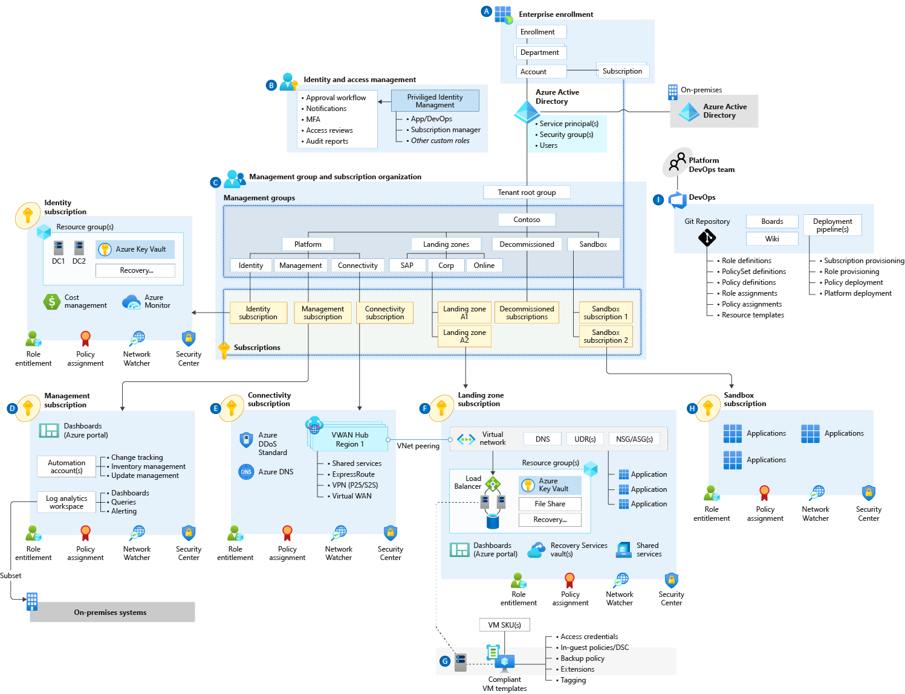
Enterprise-scale
Notes:
Enterprise-scale is an architecture approach and reference implementation that enables effective construction and operationalization of landing zones on Azure, at scale and aligned with the Azure roadmap and the Microsoft Cloud Adoption Framework for Azure. The enterprise-scale architecture provides prescriptive guidance coupled with Azure best practices, and it follows design principles across the critical design areas for the customer's Azure environment.

Slide 14
Enterprise-scale landing zone(s) The principle purpose of the “Landing Zone” is therefore to ensure that when an application or workload lands on Azure, the required “plumbing” is already in place, providing greater agility and compliance with enterprise security and governance requirements.
Notes:
The CAF enterprise-scale landing zone architecture represents the strategic design path and target technical state for the customer's Azure environment. It will continue to evolve in lockstep with the Azure platform and is ultimately defined by the various design decisions the customer organization must make to define their Azure journey.

Slide 15
Enterprise-scale Design Principles

Slide 16
Enterprise-scale Design Principles
Subscription Democratisation
Policy Driven Governance
Single Control and Management Plane
Application Centric and Archetype-Neutral
Azure Native Design and Platform Roadmap Alignment
Enable Autonomy for Innovation and Transformation
Security and Compliance By-Default
Governance At-Scale with Sustainable Cloud Engineering
Notes:
Just like organizing book in library comes with set of principals. Enterprise-scale comes with set of design principals, which are necessary for organizing resources in subscriptions. There is a purpose behind every single principal which will be discussed during this presentation.
Subscriptions should be used as a unit of management and scale aligned with business needs and priorities. You should avoid to maintain central control for subscription creation, and allow business units to create subscriptions themselves. Your governance model should ensure that as subscriptions are created and moved to different management groups, policies are applied to enforce any necessary guardrails.
Azure Policy should be used to provide the “guard-rails” and ensure the continued compliance of the customer platform and applications deployed onto it, whilst also providing application owners sufficient freedom and a secure unhindered path to cloud.
The enterprise-scale architecture should NOT rely on abstraction layers such as customer developed portals or tooling, and should provide a consistent experience for both AppOps (centrally managed operation teams) and DevOps (dedicated application operation teams).
The Enterprise-scale architecture should focus on application centric migrations and development rather than a pure infrastructure “lift and shift” migration (i.e. movement of virtual machines) and should not differentiate between old/new applications or IaaS/PaaS applications.
The Enterprise-scale architecture strongly advocates the use of native platform services and capabilities wherever possible, which should be fully aligned with Azure platform roadmaps from the offset to ensure new capabilities are swiftly made available within customer environments.
the use of native platform services and capabilities wherever possible, which should be fully aligned with Azure platform roadmaps from the offset to ensure new capabilities are swiftly made available within customer environments.

Slide 17
Enterprise-scale Design Principles
Subscription Democratization
Policy Driven Governance
Single Control and Management Plane
Application Centric and Archetype-Neutral
Azure Native Design and Platform Roadmap Alignment
Subscriptions should be used as a unit of management and scale aligned with business needs and priorities, to support business areas and portfolio owners to accelerate application migrations and new application development.
Notes:
Subscriptions should be used as a unit of management and scale aligned with business needs and priorities.
Democratization, Business can choose when they move, we want agility and velocity bult into the platform to accelerate an organizations journey.
Democratization: Subscriptions, aligned with the platform architecture, must be unblocked and provided to business lines for the design and dev/test of migrating workloads.
Subscription democratisation across the regions Equinor 1 resource group – fill and spill, Pinning subscription to region. Big can start small.
Agree at the top Level Criteria for a File>New Subscription and Requirements
Plan Top down Management and unit of Management is the Subscription. This helps to address things such as subscription Limits, maybe for a workload or service we need multiple subscriptions.

Slide 18
Enterprise-scale Design Principles
Azure Policy should be used to provide the guard-rails and ensure the continued compliance of the customer platform and applications deployed onto it, whilst also providing application owners sufficient freedom and a secure unhindered path to cloud.
Subscription Democratisation
Policy Driven Governance
Single Control and Management Plane
Application Centric and Archetype-Neutral
Azure Native Design and Platform Roadmap Alignment
Notes:
Azure Policy should be used to provide the “guard-rails” and ensure the continued compliance of the customer platform and applications deployed onto it, whilst also providing application owners sufficient freedom and a secure unhindered path to cloud.
Rule Sets, and Governance should be in code to set guard-rails. Declare the intent of the policy, Audit only vs deny designed into platform. Deploy if not exist, for configuration drift.
No Public Endpoints – deny policy, enable Audit Logging – Deploy if not exist.
Policy – VM Provisioning
The intent of Enterprise Scale to address VM configuration drift with policy to vNet with connectivity back to Corp. Ensure VM is connected to a certain OU and domain joined.
Prevent

Slide 19
Enterprise-scale Design Principles
The Enterprise-scale architecture should not consider any abstraction layers such as customer developed portals or tooling and should provide a consistent experience for both AppOps (centrally managed operation teams) and DevOps (dedicated application operation teams).
Subscription Democratisation
Policy Driven Governance
Single Control and Management Plane
Application Centric and Archetype-Neutral
Azure Native Design and Platform Roadmap Alignment
Notes:
The enterprise-scale architecture should not consider any abstraction layers such as customer developed portals or tooling and should provide a consistent experience for both AppOps (centrally managed operation teams) and DevOps (dedicated application operation teams).
Control Plane – UBS and Equinor DRM tool
User Provisioning have native access to Azure CLI, API’s, and Portal.

Slide 20
Enterprise-scale Design Principles
We should focus on application centric migrations and development rather than a pure infrastructure "lift and shift" migration (i.e. movement of virtual machines) and should not differentiate between old/new applications or IaaS/PaaS applications.
Subscription Democratisation
Policy Driven Governance
Single Control and Management Plane
Application Centric and Archetype-Neutral
Azure Native Design and Platform Roadmap Alignment
Notes:
The enterprise-scale architecture should focus on application centric migrations and development rather than a pure infrastructure “lift and shift” migration (i.e. movement of virtual machines) and should not differentiate between old/new applications or IaaS/PaaS applications.
Application Centric Migration and Agility: Support both existing application migrations and net-new application development, without discrimination between IaaS or PaaS, all while providing a consistent experience for both AppOps (centrally managed apps) and DevOps (dedicated teams) across the design and architecture outlined above
App Centric – PaaS/DbaaS
Application and workload specific design focus. Centralize Application components. Not assigned by Who needs access based on roles.

Slide 21
Enterprise-scale Design Principles
The Enterprise Scale architecture approach advocates the use of native platform services and capabilities whenever possible, which should be aligned with Azure platform roadmaps to ensure new capabilities are made available within customer environments.
Subscription Democratisation
Policy Driven Governance
Single Control and Management Plane
Application Centric and Archetype-Neutral
Azure Native Design and Platform Roadmap Alignment
Notes:
The Enterprise-scale architecture strongly advocates the use of native platform services and capabilities wherever possible, which should be fully aligned with Azure platform roadmaps from the offset to ensure new capabilities are swiftly made available within customer environments.
Native Design – H&M – PA NVA to Azure Firewall and Terraform and provider

Slide 22
Enterprise-scale Design Guidelines

Slide 23
Azure landing zones Design areas
Azure billing & Azure Active Directory tenant
Security
Identity & access management
Governance
ENVIRONMENT
COMPLIANCE
Resource organization
Management
Network topology & connectivity
Platform automation & DevOps
Notes:
Design areas (the different parts that make up Azure landing zones) are an important early step in thinking about and designing a landing zone.
Azure billing an Active Directory tenant - Proper tenant creation, enrolment, and billing setup are important early steps.
Identity and access management - Identity and access management is a primary security boundary in the public cloud. It's the foundation for any secure and fully compliant architecture.
Resource organization - As cloud adoption scales, considerations for subscription design and management group hierarchy have an impact on governance, operations management, and adoption patterns.
Network topology and connectivity - Networking and connectivity decisions are an equally important foundational aspect of any cloud architecture.
Security - Implement controls and process to protect your cloud environments
Governance - Automate auditing and enforcement of governance policies.
Management - For stable, ongoing operations in the cloud, a management baseline is required to provide visibility, operations compliance, and protect and recover capabilities.
Platform automation and DevOps - Align the best tools and templates to deploy your landing zones and supporting resources.
Split into Environment and Compliance:
Build vs Run
Starting points vs on-going iterations and refinements
Let's look at how we approach an understanding of how a cloud operating model works.

Slide 24
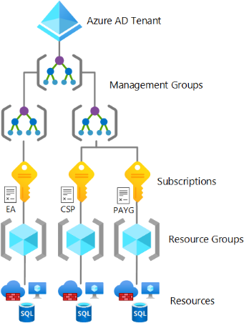

This critical design area focuses on the two highest levels of alignment across all of your Azure deployments; your Azure billing offer and the association of that offer with an Azure Active Directory (Azure AD) tenant.
Azure billing &
AAD Tenant
Notes:
If they don’t have separate identity then from the platform perspective – it is just production in test.
Examples:
Department isn’t Org chart. Create Departments only if business domains have independent IT capabilities and map customer business divisions.
If multiple AAD tenants are used, ensure the Account owner is associated with the same tenant as where subscriptions from the EA account are provisioned. Separate Dev/Test/Prod environments at an EA account level to support holistic isolation.
Do not move or rename an EA Account in AD/Azure AD
Do not ignore notification emails sent to the notification account email address. Microsoft sends important EA wide communications to this account. Setup the notification account email address to ensure notifications are sent to an appropriate group mailbox.
Assign a budget for each account and establish an alert associated with the budget.
Restrict and minimise the number of Account owners within the Enrolment to avoid the proliferation of admin access to Subscriptions and associated Azure resources

Slide 25
Billing & AAD Design Area Considerations and Recommendations
This design area references Active Directory or AD, but it doesn't focus on the identity or management aspects of Azure AD, only the tenant in which your identities will ultimately be hosted.
An Azure subscription can only trust one Azure AD tenant at a time.
If there’s no identity infrastructure, start by implementing an Azure AD only identity deployment. Don’t forget to define your Azure SSO strategy!
Add at least one custom domain and define a single-sign on strategy using AAD Connect.
Enforce MFA and CAP for all privileged accounts. No MFA and no CAP = “pleasebreachme”
Don’t forget to create a break-glass account.
Use Azure Lighthouse to grant third parties and / or Microsoft partners access to Azure. But Azure Lighthouse only supports delegation at the subscription and resource group scopes.
Avoid creating multiple Azure AD tenants.
Notes:
Keep the management group hierarchy reasonably flat, with no more than three to four levels ideally. This restriction reduces management overhead and complexity.
Avoid duplicating your organizational structure into a deeply nested management group hierarchy. Management groups should be used for policy assignment versus billing purposes. This approach necessitates using management groups for their intended purpose in enterprise-scale architecture, which is providing Azure policies for workloads that require the same type of security and compliance under the same management group level.
Create management groups under your root-level management group to represent the types of workloads (archetypes) that you'll host and ones based on their security, compliance, connectivity, and feature needs. This grouping structure allows you to have a set of Azure policies applied at the management group level for all workloads that require the same security, compliance, connectivity, and feature settings.
Use resource tags, which can be enforced or appended through Azure Policy, to query and horizontally navigate across the management group hierarchy. Then you can group resources for search needs without having to use a complex management group hierarchy.
Create a top-level sandbox management group to allow users to immediately experiment with Azure. Users can then experiment with resources that might not yet be allowed in production environments. The sandbox provides isolation from your development, test, and production environments.
Use a dedicated service principal name (SPN) to execute management group management operations, subscription management operations, and role assignment. Using an SPN reduces the number of users who have elevated rights and follows least-privilege guidelines.
Assign the User Access Administrator role at the root management group scope (/) to grant the SPN just mentioned access at the root level. After the SPN is granted permissions, the User Access Administrator role can be safely removed. In this way, only the SPN is part of the User Access Administrator role.
Assign the Contributor role to the SPN previously mentioned at the root management group scope (/), which allows tenant-level operations. This permission level ensures that the SPN can be used to deploy and manage resources to any subscription within your organization.
Create a Platform management group under the root management group to support common platform policy and Azure role assignment. This grouping structure ensures that different policies can be applied to the subscriptions used for your Azure foundation. It also ensures that the billing for common resources is centralized in one set of foundational subscriptions.
Limit the number of Azure Policy assignments made at the root management group scope (/). This limitation minimizes debugging inherited policies in lower-level management groups.
Use the policies available for enterprise-scale landing zones to enforce compliance requirements either at management group or subscription scope. Refer to guidance in the Policy-driven governance section to learn more about the governance requirements that can be addressed.
Ensure that only privileged users can operate management groups in the tenant by enabling Azure RBAC authorization in the management group hierarchy settings (by default, all users are authorized to create their own management groups under the root management group).
Configure a default, dedicated management group for new subscriptions to ensure that no subscriptions are placed under the root management group. This is especially important if there are users eligible for MSDN or Visual Studio benefits and subscriptions. A good candidate for this type of management group is a Sandbox management group.

Slide 26

Identity & Access Management
This critical design area establishes a foundation for the management of identity and access.
Notes:
Identity and Access Management in Enterprise-scale addresses Azure control plane, data plane, and application layer requirements.
Planning for Identity and Access Management begins with the Azure platform and Azure Active Directory. Many consider identity to be the primary perimeter for security. This is a shift from the traditional focus on network security. Network perimeters keep getting more porous, and that perimeter defense can’t be as effective as it was before the explosion of BYOD devices and cloud applications. Enterprise-scale recommendations focus on defining least privileged Role Based Access Control roles aligned to the customer’s operating model and leveraging Azure capabilities to apply additional layers of access control.
Use Azure AD Privileged Identity Management to establish zero standing access and to enable approval workflows for just-in-time control plane access to azure resources. Granting entitlements through PIM, rather than direct resource access, helps to protect against legacy access rights that often result from changing roles and responsibilities within an organization.
Use Azure AD PIM access reviews to periodically validate resource entitlements. Regularly scheduled reviews of access rights and entitlement use is a regulatory requirement for many customers. Determining which users had access to what resources for a given time period is much easier with PIM compared to querying AAD audit logs.
Customer RBAC roles should be used to define access rights across the Azure estate. Key roles within an organization will typically include Platform Owners, NetOps, SecOps, AppOps, and DevOps. Well defined and scoped RBAC role definitions enable subscription democratization through the segregation of duties required by an organization’s operating model.
Integrate Azure AD logs with the platform-central Azure Monitor Log Analytics workspace for audit reports and alert notifications.
Use Azure AD Managed Identities (MI) for Azure resources, avoiding username and password-based authentication. Managed Identities provide the simples and most secure method for enabling service to service communication. Managed Identities eliminate the need for credentials in your code, they rotate credentials automatically, and can be used to authenticate to any service that supports Azure AD authentication.
Multi-Factor Authentication should be enforced on all privileged accounts. If you only use a password to authenticate a user, it leaves an insecure vector for attack. If the password is weak or has been exposed elsewhere, is it really the user signing in with the username and password, or is it an attacker? When you require a second form of authentication, security is increased as this additional factor isn't something that's easy for an attacker to obtain or duplicate.
Conditional Access policies should be enforced on all privileged accounts. Azure Active Directory (Azure AD) Conditional Access (CA) analyses signals such as user, device, and location to automate decisions and enforce organizational access policies for resource. You can use CA policies to apply access controls like Multi-Factor Authentication (MFA). CA policies allow you to prompt users for MFA when needed for security and stay out of users’ way when not needed.
Planning for Authentication Inside the Landing Zone is concerned with workload access and dependencies on on-premises systems. A critical design decision enterprise organization must make when adopting Azure is whether to extend and existing on-premises identity domain into Azure or create a brand new one. Requirements for authentication inside the "Landing Zone" should therefore be thoroughly assessed and incorporated into plans to deploy AD, Azure AD-DS or both.
Examples:
Use AAD RBAC to manage data plane access to resources where possible (e.g. Key Vault, Storage Account, Azure SQL DB). Use Managed Identities instead of Service Principles for authentication to Azure services.
Evaluate the compatibility of workloads for AD and AAD-DS. Do not assume existing workloads are agnostic of AD and AAD-DS authentication, as there are differences between both approaches.
Deploy AAD-DS within the primary region as this service can be projected into only one subscription. Use Virtual Network Peering to support its usage as an authentication service.
Use Just-In-Time access for both VM access and Azure control plane administration.

Slide 27

Azure AD and Azure Roles
(Don’t confuse the two of them)
AAD Roles
Azure IAM Roles
Manage access to Azure AD resources
Can be scoped to Tenant, Administrative Unit, or Object (application)
Accessible in the Azure Portal and M365 Admin Portal
AAD Global Admin can self-assign permissions to manage Azure resources
Manage access to Azure resources
Can be scoped to Management Group, Subscription, Resource Group, or Resource
Accessible in the Azure Portal
Notes:
There are two sets of roles in any AAD Tenant. AAD Roles for managing directory and M365 resources, and Azure Roles for managing access to Azure resources.
Reference:
Azure Roles: https://docs.microsoft.com/en-us/azure/role-based-access-control/built-in-roles
AAD Roles: https://docs.microsoft.com/en-us/azure/active-directory/roles/permissions-reference

Slide 28
Identity and Access Management Design Area
Considerations and Recommendations
Consider centralized and delegated responsibilities to manage resources deployed inside the landing zone.
Which services or applications within your landing zone support Azure Active Directory authentication?
Does the organization need to extend a current on-premises Active Directory domain into Azure?
Are there applications that are partly hosted on-premises and partly hosted in Azure?
Use AAD-only groups to assign access to Azure resources & dtart with built-in Azure role definitions
Add on-premises groups to AAD-only groups where applicable
Deploy MFA + CAP for users with access to Azure & use PIM to establish zero standing access
Use custom roles where more granular access is required
Use managed identities instead of service principals for authentication to Azure services

Slide 29

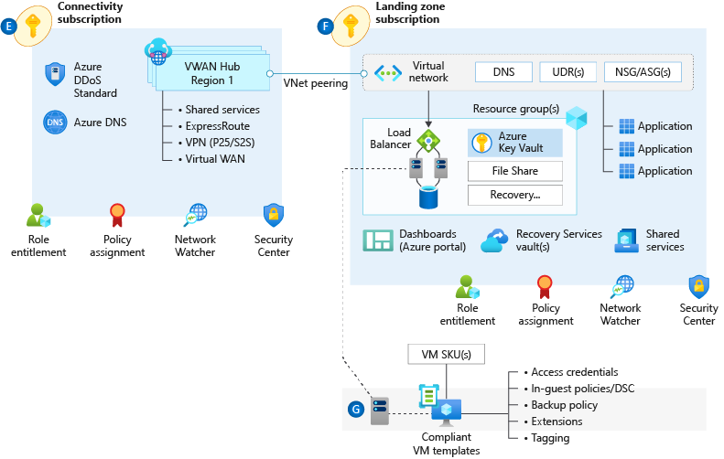
Network Topology & Connectivity
The network topology and connectivity design area is critical for establishing a foundation for your cloud network design.
Notes:
Network topology and connectivity within Enterprise-scale addresses the need for establishing the end-to-end connectivity for all landing zones in the enterprise Azure estate. The subject is both broad and complex and will likely consume a significant portion of the overall design effort. It is critical for successful delivery to ensure that you have a thorough understanding of all design areas and Enterprise-scale recommendations, common alternative solutions, and the impact of deviating from the recommendations.
DNS Configuration within Enterprise-scale will be primarily influenced by the cross-premises name resolution requirements of landing zone workloads. For environments where name resolution in Azure is all that is required, native Azure DNS services should suffice. For environments where name resolution across Azure and on-premises is required, Azure VMs integrated with existing DNS infrastructure will be required. Integration with Private Link and services with special DNS requirements, such as OpenShift, must also be factored into the design.
Tip – A common scenario here is customer extends their DNS infra to Azure (Infoblox, AD, etc) but also uses the azure DNS resolver 168.* address as a forwarder for those in-azure DNS servers to assure private link resolution.
Azure Networking Topology
Azure Virtual WAN An Azure networking topology based-on Azure Virtual WAN is the preferred Enterprise Scale approach for large scale multi-region deployments where the customer needs to interconnect all their global locations on both Azure and on-premises. Azure Virtual WAN provides multiple advantages over traditional Azure networking, including:
Azure Virtual WAN is a Microsoft-managed solution, where end-to-end global transit connectivity is provided out-of-the-box. Virtual WAN Hubs eliminate the need for customers to manually setup the network connectivity. As an example, customer does not require to setup UDRs or NVAs to enable global transit connectivity.
Azure Virtual WAN greatly simplifies end-to-end network connectivity in Azure and cross-premises by creating a hub and spoke network architecture that spans multiple Azure regions and on-premises locations (any-to-any connectivity) out-of-the-box.
Azure Virtual WAN increases the limit of up to 200 prefixes advertised from Azure to on-premises via ExpressRoute Private Peering to 10,000 prefixes per single Virtual WAN Hub. The limit of 10,000 prefixes also includes VPN (S2S and P2S VPN).
Traditional Azure Networking can also be used to build a secure network foundation aligned to the Enterprise Scale design principles. A traditional Azure networking topology should be used for customers that either:
only intend to deploy resources in a few Azure regions
have no need for a global interconnected network
have a low number of remote/branch locations per region (less than 30), and/or
require full control and granularity for manually configuring their Azure network.
Tip: The decision point here is usually boils down to two things; do you want managed transit networking? If yes, then vwan. Do you need to ensure vnets cannot communicate with each other by default? (if so hub/spoke), but the details above will also impact the decision. Making sure the customer is aware of the differences will lead to the right conversation to make the decision.
Connectivity to Azure is concerned with establishing private connectivity from on-premises locations to Azure. Private connectivity options include ExpressRoute, ExpressRoute Global Reach, ExpressRoute Direct, Site-to-Site VPN, and Point-to-Site VPN. It will be necessary to fully understand the customer's various connectivity scenarios to align feature capabilities with customer requirements. Enterprise-scale design recommendations include:
Use ExpressRoute as the primary connectivity channel for connecting on-premises network to Microsoft Azure.
VPNs can be used as a source of backup connectivity to enhance connectivity resiliency and/or as a short-term solution while ExpressRoute ‘last mile’ connectivity is provisioned for customers that are not already either in a provider facility or have connectivity with an ER provider.
Use ExpressRoute Global Reach to connect large offices /regional headquarters/datacenter that are connected to Azure via ExpressRoute.
Do not use the same ExpressRoute circuit to connect multiple environments that require isolation or dedicated bandwidth, so as to avoid "noisy neighbour" risks.
Tip: A wise CSA once said “There are two types of enterprise Azure customers. Those with express route and those using a VPN while waiting for last mile connectivity.” A VPN backup of ExpressRoute is a great solution as well, but customers can also use multiple ER circuits at multiple peering locations. VPN is not a good backup to ER if the customer has the same provider for ER as for internet breakout as a provider outage will impact both.
Connectivity to Azure PaaS services can come in many forms and each service in the customer's Azure estate should be examined to ensure their requirements are met by the connectivity design. Azure PaaS services are typically accessed over public endpoints, though many PaaS services provide capabilities to secure such endpoints or even make them entirely private.
Private Link provides dedicated access using private IP addresses to Azure PaaS instances, or custom services behind an Azure Load Balancer Standard.
VNet injection provides dedicated private deployments for supported services. However, management plane traffic flows through public IP addresses. It is critical to understand how traffic routing within a virtual network can influence the management plane traffic in this scenario and affect the stability of the service.
VNet Service Endpoints provide service level access from selected subnets to selected PaaS services. When using Service Endpoints it is important to ensure concerns with data exfiltration are addressed.
Tip: Most enterprises will want to use private link wherever possible as the existence of a public IP perceived is a level of risk.
Planning for Inbound and Outbound Internet Connectivity often involves separating customers from their existing on-premises tools and practices. For example, customers will frequently want to force tunnel egress traffic back on-premises for inspection or replicate on-premises DMZ architectures in Azure. This is where we rely on the Enterprise-scale design principles to drive to a better architecture.
Azure native network security services such as Azure Firewall, Application Gateway WAF, and Azure Front Door WAF are fully managed services, meaning that customers do not incur the operational and management costs associated with infrastructure deployments, which can become complex at scale.
The Enterprise Scale architecture is fully compatible with 3rd party NVAs, should the customer prefer to use NVAs or for situations where native services do not satisfy specific customer requirements.
Tip: Many enterprise customers have 100’s of 3rd party firewalls deployed and want to maintain that ‘single pain of glass’ management for Azure. While this works and is supported 3rd party NVAs generally don’t scale as well as cloud native/first party products. Some customers have then used first party for use cases where business needs demanded better scale/throughput.
Planning for Application Delivery focuses on application delivery within the landing zone. From the Enterprise-scale perspective, application delivery services, such as Application Gateway and Front Door, are an application component and should reside within the landing zone and be managed by the application owners. By leverage Azure Policy to ensure complaint service configuration, the customer maintain central governance while enabling the business.
Azure Load Balancer (internal and public) provides high availability for application delivery at a regional level.
Azure Application Gateway allows the secure delivery of HTTP/S applications at a regional level.
Azure Front Door allows the secure delivery of highly available HTTP/S applications across Azure regions.
Azure Traffic manager allows the delivery of global applications.
It is recommended to use the WAF capabilities provided by Application Gateway and Front Door. When using both services, it is recommended to use AFD WAF, placing the protection closer to the edge.
Azure DDoS standard is recommended on all public endpoints within customer virtual networks.
Tip: A global web app would use front door to connect the user to the closest edge, then application gateway to load balance in the destination azure region.
Planning for Landing Zone Network Segmentation explores key recommendations to deliver highly secure internal network segmentation within a "Landing Zone" to drive a network Zero Trust implementation.
The Zero Trust model assumes a breached state and verifies each request as though it originates from an uncontrolled network.
An advanced Zero Trust network implementation employs fully distributed ingress/egress cloud micro-perimeters and deeper micro-segmentation.
Network Security Groups can use Azure Service Tags to facilitate connectivity to Azure PaaS services.
Use NSGs and ASGs to microsegment traffic within the "Landing Zone" and avoid using a central NVA to filter these traffic flows.
It is recommended to enable NSG Flow Logs and feed them into Traffic Analytics to gain insights into internal and external traffic flows.
For VWAN-based network topologies, route traffic across "Landing Zones" via Azure Firewall only if the customer requires filtering and logging capabilities for traffic flowing across "Landing Zones".
Tip: NSGs can be used to implement zero trust principles but keep in mind they don’t inspect traffic (I.E. if the NSG is allow 443 and a bad actor tunnels ssh through 443, the nsg will allow it where a NGFW would block it).
Network Encryption explores key recommendations to achieve network encryption between on-premises and Azure as well as across Azure regions.
Cost and available bandwidth are inversely proportional to length of encryption tunnel between endpoints.
When using VPN to connect to Azure, traffic is encrypted over the internet via IPsec tunnels.
When using ExpressRoute with Private Peering, traffic is not currently encrypted.
MACsec encryption can be applied to ExpressRoute Direct to achieve network encryption.
Azure does not currently offer native encryption over Global VNet Peering.
Tip: Ipsec can also be used on individual VMs to encrypt traffic. Also, many customers falsely assume every bit of traffic in any public cloud is encrypted by default (like storage is).
Traffic Inspection - In many industries customers require that traffic in Azure, particularly inbound and outbound internet traffic, is mirrored to a network packet collector for deep inspection and analysis. This section therefore explores key considerations and recommended approaches for mirroring or tapping traffic within Azure Virtual Networks.
Azure Virtual Network TAP (VTAP) is in preview, but your must reach to azurevnettap@microsoft.com for availability details.
Network Watcher packet captures in Network Watcher is GA, but captures are limited to a maximum period of 5 hours.
Use Network Watcher packet capture despite the limited capture window.
Evaluate if NSG Flow Logs v2 provide the level of detail required.
Use 3rd party solutions for scenarios where sustained deep packet inspection is required.
Do not develop a custom solution to mirror traffic. While this might be acceptable for small scale scenarios, this approach is not encouraged at scale due to complexity and supportability issues which may arise.
Tip: Any enterprise with a requirement for ‘deep packet inspection’ is going to use a 3rd party NVA until azfw supports it (NDA roadmap).

Slide 30
Network Topology & Connectivity Design Area Considerations & Recommendations
Define a topology. There’s only 2 – Hub & Spoke (default option for nearly all cases in GR) and Virtual WAN.
Plan IP Addressing. Don’t use /16 unless really needed. Use at least /23 for Hub. Avoid overlapping IP address, including BCDR scenarios. Azure reserves 5 IP addresses from every subnet. Some Azure services require dedicated subnets. These dedicated subnets might have restrictions around naming, sizing, NSGs, and UDRs.
When you use multiple ExpressRoute circuits, optimize ExpressRoute routing via BGP local preference and AS PATH prepending. Deploy a zone-redundant ExpressRoute gateway in the supported Azure regions.
Use ExpressRoute Insights, Network Watcher, and Connection Monitor.
Use virtual network injection for supported Azure services to make them available from within your virtual network.
Azure PaaS services that have been injected into a virtual network still perform management plane operations by using public IP addresses. Ensure that this communication is locked down within the virtual network by using UDRs and NSGs.
Notes:
Keep the management group hierarchy reasonably flat, with no more than three to four levels ideally. This restriction reduces management overhead and complexity.
Avoid duplicating your organizational structure into a deeply nested management group hierarchy. Management groups should be used for policy assignment versus billing purposes. This approach necessitates using management groups for their intended purpose in enterprise-scale architecture, which is providing Azure policies for workloads that require the same type of security and compliance under the same management group level.
Create management groups under your root-level management group to represent the types of workloads (archetypes) that you'll host and ones based on their security, compliance, connectivity, and feature needs. This grouping structure allows you to have a set of Azure policies applied at the management group level for all workloads that require the same security, compliance, connectivity, and feature settings.
Use resource tags, which can be enforced or appended through Azure Policy, to query and horizontally navigate across the management group hierarchy. Then you can group resources for search needs without having to use a complex management group hierarchy.
Create a top-level sandbox management group to allow users to immediately experiment with Azure. Users can then experiment with resources that might not yet be allowed in production environments. The sandbox provides isolation from your development, test, and production environments.
Use a dedicated service principal name (SPN) to execute management group management operations, subscription management operations, and role assignment. Using an SPN reduces the number of users who have elevated rights and follows least-privilege guidelines.
Assign the User Access Administrator role at the root management group scope (/) to grant the SPN just mentioned access at the root level. After the SPN is granted permissions, the User Access Administrator role can be safely removed. In this way, only the SPN is part of the User Access Administrator role.
Assign the Contributor role to the SPN previously mentioned at the root management group scope (/), which allows tenant-level operations. This permission level ensures that the SPN can be used to deploy and manage resources to any subscription within your organization.
Create a Platform management group under the root management group to support common platform policy and Azure role assignment. This grouping structure ensures that different policies can be applied to the subscriptions used for your Azure foundation. It also ensures that the billing for common resources is centralized in one set of foundational subscriptions.
Limit the number of Azure Policy assignments made at the root management group scope (/). This limitation minimizes debugging inherited policies in lower-level management groups.
Use the policies available for enterprise-scale landing zones to enforce compliance requirements either at management group or subscription scope. Refer to guidance in the Policy-driven governance section to learn more about the governance requirements that can be addressed.
Ensure that only privileged users can operate management groups in the tenant by enabling Azure RBAC authorization in the management group hierarchy settings (by default, all users are authorized to create their own management groups under the root management group).
Configure a default, dedicated management group for new subscriptions to ensure that no subscriptions are placed under the root management group. This is especially important if there are users eligible for MSDN or Visual Studio benefits and subscriptions. A good candidate for this type of management group is a Sandbox management group.

Slide 31
Network Topology & Connectivity Design Area Considerations & Recommendations
Use Private Link, where available, for shared Azure PaaS services. Private Link is generally available for several services and is in public preview for other services.
Use virtual network service endpoints to secure access to Azure PaaS services from within your virtual network, but only when Private Link isn't available and there are no data exfiltration concerns. Don't use virtual network service endpoints when there are data exfiltration concerns, unless you use NVA filtering.
Perform application delivery within landing zones for both internal-facing and external-facing applications. For secure delivery of HTTP/S applications, use Application Gateway v2 and ensure that WAF protection and policies are enabled. Use a partner NVA if you can't use Application Gateway v2 for the security of HTTP/S applications.
When you're using Front Door and Application Gateway to help protect HTTP/S applications, use WAF policies in Front Door. Lock down Application Gateway to receive traffic only from Front Door.
Plan for inbound and outbound internet connectivity. Use Azure Firewall to govern outbound internet traffic and east / west traffic.
Notes:
Keep the management group hierarchy reasonably flat, with no more than three to four levels ideally. This restriction reduces management overhead and complexity.
Avoid duplicating your organizational structure into a deeply nested management group hierarchy. Management groups should be used for policy assignment versus billing purposes. This approach necessitates using management groups for their intended purpose in enterprise-scale architecture, which is providing Azure policies for workloads that require the same type of security and compliance under the same management group level.
Create management groups under your root-level management group to represent the types of workloads (archetypes) that you'll host and ones based on their security, compliance, connectivity, and feature needs. This grouping structure allows you to have a set of Azure policies applied at the management group level for all workloads that require the same security, compliance, connectivity, and feature settings.
Use resource tags, which can be enforced or appended through Azure Policy, to query and horizontally navigate across the management group hierarchy. Then you can group resources for search needs without having to use a complex management group hierarchy.
Create a top-level sandbox management group to allow users to immediately experiment with Azure. Users can then experiment with resources that might not yet be allowed in production environments. The sandbox provides isolation from your development, test, and production environments.
Use a dedicated service principal name (SPN) to execute management group management operations, subscription management operations, and role assignment. Using an SPN reduces the number of users who have elevated rights and follows least-privilege guidelines.
Assign the User Access Administrator role at the root management group scope (/) to grant the SPN just mentioned access at the root level. After the SPN is granted permissions, the User Access Administrator role can be safely removed. In this way, only the SPN is part of the User Access Administrator role.
Assign the Contributor role to the SPN previously mentioned at the root management group scope (/), which allows tenant-level operations. This permission level ensures that the SPN can be used to deploy and manage resources to any subscription within your organization.
Create a Platform management group under the root management group to support common platform policy and Azure role assignment. This grouping structure ensures that different policies can be applied to the subscriptions used for your Azure foundation. It also ensures that the billing for common resources is centralized in one set of foundational subscriptions.
Limit the number of Azure Policy assignments made at the root management group scope (/). This limitation minimizes debugging inherited policies in lower-level management groups.
Use the policies available for enterprise-scale landing zones to enforce compliance requirements either at management group or subscription scope. Refer to guidance in the Policy-driven governance section to learn more about the governance requirements that can be addressed.
Ensure that only privileged users can operate management groups in the tenant by enabling Azure RBAC authorization in the management group hierarchy settings (by default, all users are authorized to create their own management groups under the root management group).
Configure a default, dedicated management group for new subscriptions to ensure that no subscriptions are placed under the root management group. This is especially important if there are users eligible for MSDN or Visual Studio benefits and subscriptions. A good candidate for this type of management group is a Sandbox management group.

Slide 32

Resource Organization
The critical resource organization design area establishes consistent patterns for organizing resources deployed to the cloud.
Notes:
Main talking Points
Subscription Organization and Governance
Use Management Group structure within an AAD tenant to support org mapping
Must be appropriately considered when planning Azure adoption at-scale
Configure Subscription Quota and Capacity
Platform limits and quotas within the Azure platform for services
Availability of required SKUs in chosen Azure regions
Subscription quotas are not capacity guarantees and are per region
Establish Cost Management
Potential need for chargeback models where shared PaaS services are concerned, such as ASE which may need to be shared to achieve higher density
Shutdown schedule for non-prod workloads to optimise costs
Further Talking Point
Define Management Group Hierarchy Within an Azure AD tenant, Management Group structures help to support organizational mapping and must therefore be appropriately considered when planning Azure adoption at-scale.
Management groups can be used to aggregate Policy and Initiative assignments.
A management group tree can support up to six levels of depth. This limit doesn't include the Root level or the subscription level.
Subscription Organization and Governance Subscriptions are a unit of management, billing, and scale within Azure
Subscriptions serve as a boundary for the assignment of Azure policies.
Subscriptions serve as a scale unit so that component workloads can scale within the platform subscription limits.
Subscriptions provide a management boundary for governance and isolation, allowing for a clear separation of concerns.
Subscription Quotas and Capacity It is essential to ensure that sufficient capacity and SKUs are available. Every Azure region contains a finite set of resources at any given time.
Limits and quotas within the Azure platform for each service your workloads require.
Availability of required SKUs within chosen Azure regions.
Subscription quotas are not capacity guarantees and are applied on a per region basis.
Cost Management Cost transparency across a technical estate is a critical management challenge faced by every large enterprise organization
Using a shutdown schedule for non-production workloads to optimize costs
Using Azure Advisor to check cost optimization recommendations.
Potential need for chargeback models where shared PaaS services are concerned, such as ASE and AKS which may need to be shared to achieve higher density

Slide 33
Resource Organization Design Area Considerations and Recommendations
Avoid replicating the organization’s hierarchy chart. What if the customer goes thru a re-org?
Avoid organizing for billing purposes. Use Tags (accounting) + Azure Cost Management to query & aggregate costs. Make it available to application owners.
Keep the management group hierarchy flat (3-4 levels)
Focus on organizing based upon Azure Policy Assignments (e.g., restrict public IP on internal workloads, prod/non-prod naming conventions, etc.)
Utilize a sandbox management group & configure a default management group for new subscriptions
Limit Policy assignments made at the root management group
Create management groups to represent regulatory workloads (GDPR, PCI, region-locked, etc.)
Consider limits and quotas within the Azure platform for each service that your workloads require.
Use reserved instances to prioritize reserved capacity in required regions.
Notes:
Keep the management group hierarchy reasonably flat, with no more than three to four levels ideally. This restriction reduces management overhead and complexity.
Avoid duplicating your organizational structure into a deeply nested management group hierarchy. Management groups should be used for policy assignment versus billing purposes. This approach necessitates using management groups for their intended purpose in enterprise-scale architecture, which is providing Azure policies for workloads that require the same type of security and compliance under the same management group level.
Create management groups under your root-level management group to represent the types of workloads (archetypes) that you'll host and ones based on their security, compliance, connectivity, and feature needs. This grouping structure allows you to have a set of Azure policies applied at the management group level for all workloads that require the same security, compliance, connectivity, and feature settings.
Use resource tags, which can be enforced or appended through Azure Policy, to query and horizontally navigate across the management group hierarchy. Then you can group resources for search needs without having to use a complex management group hierarchy.
Create a top-level sandbox management group to allow users to immediately experiment with Azure. Users can then experiment with resources that might not yet be allowed in production environments. The sandbox provides isolation from your development, test, and production environments.
Use a dedicated service principal name (SPN) to execute management group management operations, subscription management operations, and role assignment. Using an SPN reduces the number of users who have elevated rights and follows least-privilege guidelines.
Assign the User Access Administrator role at the root management group scope (/) to grant the SPN just mentioned access at the root level. After the SPN is granted permissions, the User Access Administrator role can be safely removed. In this way, only the SPN is part of the User Access Administrator role.
Assign the Contributor role to the SPN previously mentioned at the root management group scope (/), which allows tenant-level operations. This permission level ensures that the SPN can be used to deploy and manage resources to any subscription within your organization.
Create a Platform management group under the root management group to support common platform policy and Azure role assignment. This grouping structure ensures that different policies can be applied to the subscriptions used for your Azure foundation. It also ensures that the billing for common resources is centralized in one set of foundational subscriptions.
Limit the number of Azure Policy assignments made at the root management group scope (/). This limitation minimizes debugging inherited policies in lower-level management groups.
Use the policies available for enterprise-scale landing zones to enforce compliance requirements either at management group or subscription scope. Refer to guidance in the Policy-driven governance section to learn more about the governance requirements that can be addressed.
Ensure that only privileged users can operate management groups in the tenant by enabling Azure RBAC authorization in the management group hierarchy settings (by default, all users are authorized to create their own management groups under the root management group).
Configure a default, dedicated management group for new subscriptions to ensure that no subscriptions are placed under the root management group. This is especially important if there are users eligible for MSDN or Visual Studio benefits and subscriptions. A good candidate for this type of management group is a Sandbox management group.

Slide 34
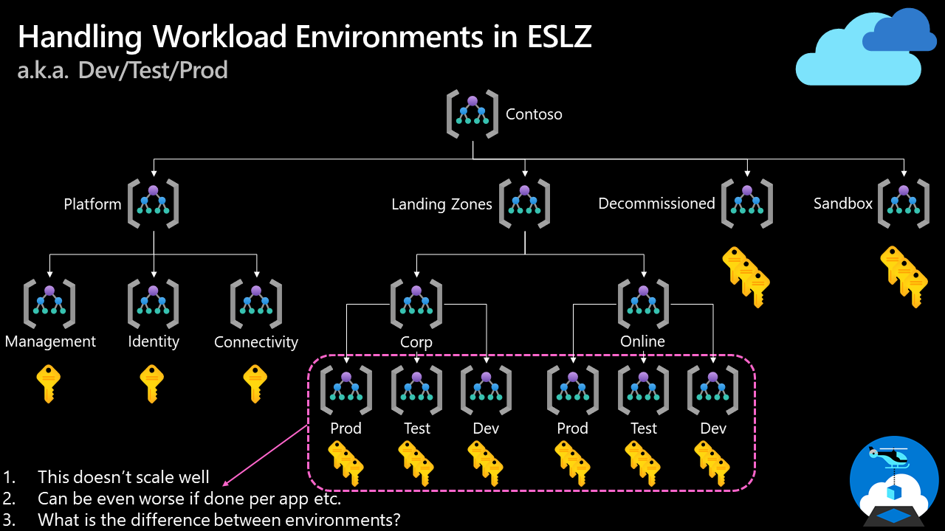
How do we handle "dev/test/production" workload landing zones in enterprise-scale architecture?
Notes:
Keep the management group hierarchy reasonably flat, with no more than three to four levels ideally. This restriction reduces management overhead and complexity.
Avoid duplicating your organizational structure into a deeply nested management group hierarchy. Management groups should be used for policy assignment versus billing purposes. This approach necessitates using management groups for their intended purpose in enterprise-scale architecture, which is providing Azure policies for workloads that require the same type of security and compliance under the same management group level.
Create management groups under your root-level management group to represent the types of workloads (archetypes) that you'll host and ones based on their security, compliance, connectivity, and feature needs. This grouping structure allows you to have a set of Azure policies applied at the management group level for all workloads that require the same security, compliance, connectivity, and feature settings.
Use resource tags, which can be enforced or appended through Azure Policy, to query and horizontally navigate across the management group hierarchy. Then you can group resources for search needs without having to use a complex management group hierarchy.
Create a top-level sandbox management group to allow users to immediately experiment with Azure. Users can then experiment with resources that might not yet be allowed in production environments. The sandbox provides isolation from your development, test, and production environments.
Use a dedicated service principal name (SPN) to execute management group management operations, subscription management operations, and role assignment. Using an SPN reduces the number of users who have elevated rights and follows least-privilege guidelines.
Assign the User Access Administrator role at the root management group scope (/) to grant the SPN just mentioned access at the root level. After the SPN is granted permissions, the User Access Administrator role can be safely removed. In this way, only the SPN is part of the User Access Administrator role.
Assign the Contributor role to the SPN previously mentioned at the root management group scope (/), which allows tenant-level operations. This permission level ensures that the SPN can be used to deploy and manage resources to any subscription within your organization.
Create a Platform management group under the root management group to support common platform policy and Azure role assignment. This grouping structure ensures that different policies can be applied to the subscriptions used for your Azure foundation. It also ensures that the billing for common resources is centralized in one set of foundational subscriptions.
Limit the number of Azure Policy assignments made at the root management group scope (/). This limitation minimizes debugging inherited policies in lower-level management groups.
Use the policies available for enterprise-scale landing zones to enforce compliance requirements either at management group or subscription scope. Refer to guidance in the Policy-driven governance section to learn more about the governance requirements that can be addressed.
Ensure that only privileged users can operate management groups in the tenant by enabling Azure RBAC authorization in the management group hierarchy settings (by default, all users are authorized to create their own management groups under the root management group).
Configure a default, dedicated management group for new subscriptions to ensure that no subscriptions are placed under the root management group. This is especially important if there are users eligible for MSDN or Visual Studio benefits and subscriptions. A good candidate for this type of management group is a Sandbox management group.

Slide 35
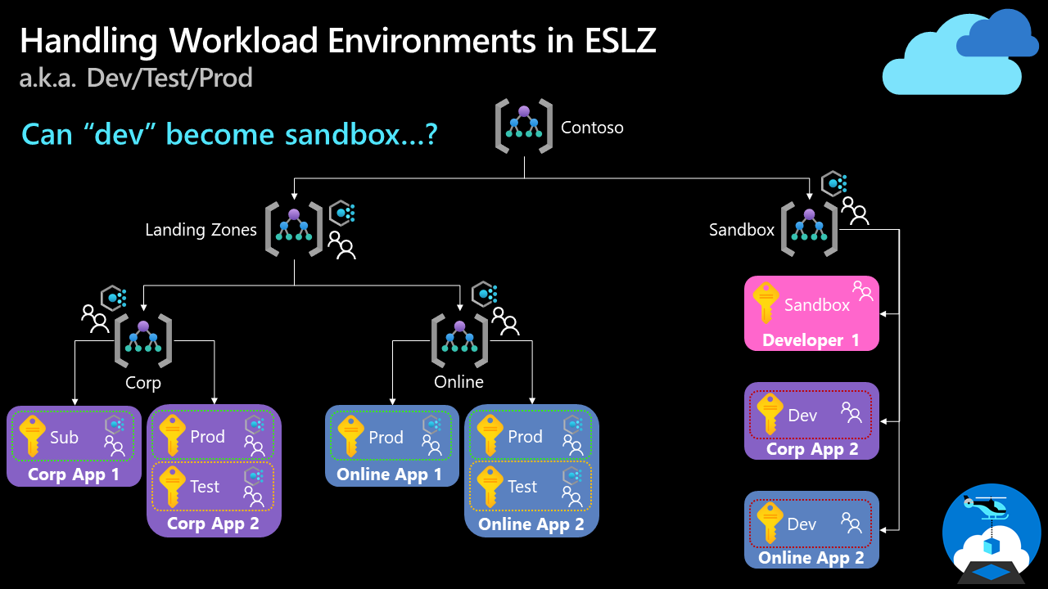
How do we handle "dev/test/production" workload landing zones in enterprise-scale architecture?
Note: We discussed this topic in our enterprise-scale community call in August 2021. You can find the recording on YouTube.
Notes:
Keep the management group hierarchy reasonably flat, with no more than three to four levels ideally. This restriction reduces management overhead and complexity.
Avoid duplicating your organizational structure into a deeply nested management group hierarchy. Management groups should be used for policy assignment versus billing purposes. This approach necessitates using management groups for their intended purpose in enterprise-scale architecture, which is providing Azure policies for workloads that require the same type of security and compliance under the same management group level.
Create management groups under your root-level management group to represent the types of workloads (archetypes) that you'll host and ones based on their security, compliance, connectivity, and feature needs. This grouping structure allows you to have a set of Azure policies applied at the management group level for all workloads that require the same security, compliance, connectivity, and feature settings.
Use resource tags, which can be enforced or appended through Azure Policy, to query and horizontally navigate across the management group hierarchy. Then you can group resources for search needs without having to use a complex management group hierarchy.
Create a top-level sandbox management group to allow users to immediately experiment with Azure. Users can then experiment with resources that might not yet be allowed in production environments. The sandbox provides isolation from your development, test, and production environments.
Use a dedicated service principal name (SPN) to execute management group management operations, subscription management operations, and role assignment. Using an SPN reduces the number of users who have elevated rights and follows least-privilege guidelines.
Assign the User Access Administrator role at the root management group scope (/) to grant the SPN just mentioned access at the root level. After the SPN is granted permissions, the User Access Administrator role can be safely removed. In this way, only the SPN is part of the User Access Administrator role.
Assign the Contributor role to the SPN previously mentioned at the root management group scope (/), which allows tenant-level operations. This permission level ensures that the SPN can be used to deploy and manage resources to any subscription within your organization.
Create a Platform management group under the root management group to support common platform policy and Azure role assignment. This grouping structure ensures that different policies can be applied to the subscriptions used for your Azure foundation. It also ensures that the billing for common resources is centralized in one set of foundational subscriptions.
Limit the number of Azure Policy assignments made at the root management group scope (/). This limitation minimizes debugging inherited policies in lower-level management groups.
Use the policies available for enterprise-scale landing zones to enforce compliance requirements either at management group or subscription scope. Refer to guidance in the Policy-driven governance section to learn more about the governance requirements that can be addressed.
Ensure that only privileged users can operate management groups in the tenant by enabling Azure RBAC authorization in the management group hierarchy settings (by default, all users are authorized to create their own management groups under the root management group).
Configure a default, dedicated management group for new subscriptions to ensure that no subscriptions are placed under the root management group. This is especially important if there are users eligible for MSDN or Visual Studio benefits and subscriptions. A good candidate for this type of management group is a Sandbox management group.

Slide 36

Security
This design area creates a foundation for security across your Azure, hybrid, and multicloud environments.
You can enhance this foundation later with security guidance outlined in the Cloud Adoption Framework's Secure methodology.
Notes:
TALK TRACK:
ES is secure by design leveraging
Azure DepolyIfNotExist Policies
Centralized Identity & Access Mgmt with PIM, MFA, Conditional Access to provide the components for Zero-Trust
Protect secrets with a strategic Key Vault approach
All logs go to a centralized Log Analytics Workspace
Azure Security Center for
Key Message: Key Vaults are for applications
Emphasis on central management with policies to ensure compliance and to not reach scale limits.
Key Vault should be centrally managed, but not centrally deployed.
Key Vault should not be in a dedicated subscription as a shared service.
Key Vault, by design, should be distributed across the applications that need it.
Identity & Access
Leverage PIM for roles assignments to avoid permanent access.
Use of custom roles to add granularity to the permissions

Slide 37
Security Design Area Considerations and Recommendations
Which teams require notifications for security alerts?
What about emergency patching for critical vulnerabilities?
Who requires access to encryption keys in the environment? And who will be responsible for managing the keys?
Develop and follow a roadmap to secure privileged access against cyber attackers.
Use AAD PIM, identify & categorize accounts in highly privileged roles, define at least two break-glass accounts, enforce MFA and CAP.
Enable Defender for Cloud to protect your environment and your workloads.
Use Security Posture to monitor your overall security posture. Use the Secure Score Over Time workbook.
Apply Zero-Trust and Defense-in-Depth principles. Apply and enforce network segmentation.
Use Azure Policies to audit and enforce governance around security, compliance and regulatory requirements. Limit the number of Azure Policy assignments made at the root management group scope to avoid managing through exclusions at inherited scopes.

Slide 38
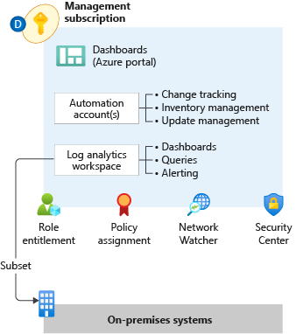

Management
This design area establishes a foundation for operations management across your Azure, hybrid, or multicloud environments.
Notes:
Management & monitoring in Enterprise-scale is primarily concerned with how an enterprise can operationalize and centrally govern their Azure estate. Management and monitoring recommendations align to the Enterprise-scale design principles and focus on native Azure capabilities. Where customers deviate from recommendations, it is important to highlight the design complexities, administrative burden, gaps in observability, and costs of third-party solutions. Defaulting to a customer’s existing toolset often proves challenging and slows adoption.
Role Entitlement
Role entitlement refers to the implementation of fine-grained RBAC controls, with appropriate access at the appropriate scope, in conjunction with PIM and aligned with the operating model. Within the context of the Management subscription, the focus of Enterprise-scale is on providing central IT with visibility across the platform to ensure the enterprise Azure estate can be operationally maintained. Areas of visibility include audit logs, patch status, and security alerts.
Policy Assignment
Policy assignments establish the guard rails that allow for subscription management to be distributed while remaining centrally governed, enabling subscription democratization. Within the context of the Management subscription, the focus of Enterprise-scale is on ensuring the appropriate resources are in place and ready for consumption by platform services and landing zones.
Archetype Templates
Management and monitoring within Enterprise-scale must be designed with application archetypes in mind. Every large-scale enterprise software estate will encompass a myriad of application archetypes, and each archetype may require a different migration/transformation path to Azure; a VM workload is not migrated the same way as SAP workloads. The management and monitoring design must account for these differences to ensure the proper guard rails and observability are in place and ready to consume at time of landing zone deployment.
Azure Monitor Logs (aka Log Analytics)
Centralized logging is critical to the visibility that's required by the operations management teams. The centralization of logging drives reports about change management, service health, configuration, and most other aspects of IT operations. Converging on a centralized workspace model reduces administrative effort and reduces the chances for gaps in observability.
Log Queries help you to fully leverage the value of the data collected in Azure Monitor Logs. A powerful query language allows you to join data from multiple tables, aggregate large sets of data, and perform complex operations with minimal code. Virtually any question can be answered, and analysis performed if the supporting data has been collected, and you understand how to construct the right query.
The goal of alerting is notification for significant events. Azure Monitor provides a unified alerting experience across platform and resource, with activity logs, metrics, and resource logs signal types.
Metric alerts in Azure Monitor work on top of multi-dimensional metrics. These metrics could be platform metrics, custom metrics, popular logs from Azure Monitor converted to metrics and Application Insights metrics. Metric alerts evaluate at regular intervals to check if conditions on one or more metric time-series are true and notify you when the evaluations are met. Metric alerts are stateful, that is, they only send out notifications when the state changes.
Log search rules are created by Azure Alerts to automatically run specified log queries at regular intervals. If the results of the log query match particular criteria, then an alert record is created.
Activity log alerts are alerts that activate when a new activity log event occurs that matches the conditions specified in the alert.
Dashboards
The goal within Enterprise-scale for visualizations is a curated set of dashboards built for specific personas in the operating model.
Azure Workbooks are the platform visualization capability where current development efforts are focused.
Workbooks provide a flexible canvas for data analysis and the creation of rich visual reports within the Azure portal. They allow you to tap into multiple data sources from across Azure and combine them into unified interactive experiences.
Workbooks can query data from multiple sources within Azure. Authors of workbooks can transform this data to provide insights into the availability, performance, usage, and overall health of the underlying components. For instance, analyzing performance logs from virtual machines to identify high CPU or low memory instances and displaying the results as a grid in an interactive report.
But the real power of workbooks is the ability to combine data from disparate sources within a single report. This allows for the creation of composite resource views or joins across resources enabling richer data and insights that would otherwise be impossible.
Workbooks are currently compatible with the following data sources:
Logs
Metrics
Azure Resource Graph
Alerts (Preview)
Workload Health (Preview)
Azure Resource Health (Preview)
Azure Data Explorer (Preview)
Automation Accounts
Centralized Azure Automation accounts provide application landing zones with easily consumable management services, and they provide central IT with the visibility and control required to ensure compliance with enterprise standards. Integration with Azure Policy ensures resources are configured correctly at time of deployment.
Update Management in Azure Automation can be used to manage operating system updates for Windows and Linux machines in Azure, in on-premises environments, and in other cloud environments.
Inventory Management in Azure Automation provides the ability to collect and view inventory for software, files, Linux daemons, Windows services, and Windows Registry keys on your computers.
Change Tracking in Azure Automation provides insight into changes to Windows software, Linux software packages, Windows and Linux files, Windows registry keys, Microsoft services, and Linux daemons on your computers.
Network Watcher
Azure Network Watcher provides tools to monitor, diagnose, view metrics, and enable or disable logs for resources in an Azure virtual network. Network Watcher is designed to monitor and repair the network health of IaaS (Infrastructure-as-a-Service) products which includes Virtual Machines, Virtual Networks, Application Gateways, Load balancers, etc.
Security Center
Azure Security Center also plays an important part in your monitoring strategy. It can help you monitor the security of your machines, networks, storage, data services, and applications. Security Center provides advanced threat detection by using machine learning and behavioral analytics to help identify active threats targeting your Azure resources. It also provides threat protection that blocks malware or other unwanted code and reduces the surface area exposed to brute force and other network attacks.
When Security Center identifies a threat, it triggers a security alert with steps you need to take to respond to an attack. It also provides a report with information about the threat that was detected.

Slide 39
Management Design Area
Considerations and Recommendations
Observability not Monitoring. Seek total visibility, a key monitoring principle, as soon as possible.
Once initial observability is achieved, then you build upon that initial level of visibility to develop actionable alerts, create useful dashboards, and evaluate AIOps solutions.
The Azure LZ Accelerator includes diagnostic settings for activity logs, VMs, and PaaS resources sent to Log Analytics.
Use a single monitor logs workspace to manage platforms centrally except where Azure RBAC, data sovereignty requirements, and data retention policies mandate separate workspaces.
Export logs to Azure Storage if log retention requirements exceed two years.
Use Azure Monitor Metrics for time-sensitive analysis. Use Azure Monitor Logs for insights and reporting. Use Azure Monitor alerts for generating operational alerts.
Don't send raw log entries back to on-premises monitoring systems. Instead, adopt a principle that data born in Azure stays in Azure.
Use Update Management in Azure Automation as a long-term patching mechanism for both Windows and Linux VM.

Slide 40
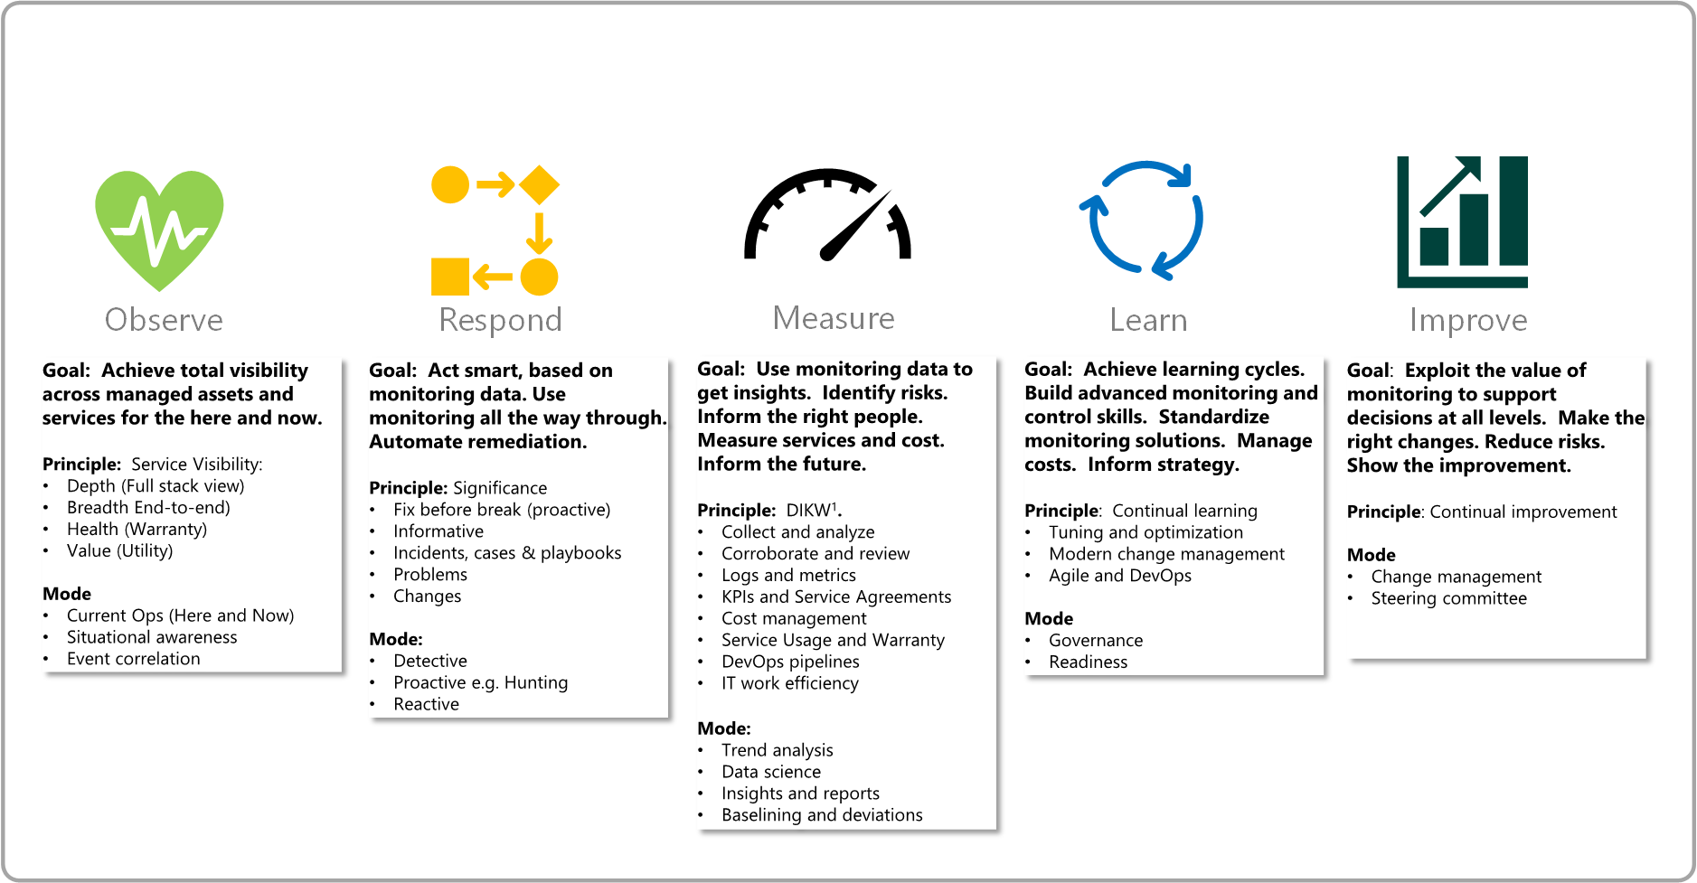
Management Design Area
The 5 Disciplines of Monitoring

Slide 41

Management Protect and Recover
Murphy’s law
"Anything that can go wrong will go wrong.“
Also, because sh!t happens.
Notes:
Having a business continuity and disaster recovery plan is essential for organizations as it aids in the time it will take for an organization to resume work in the aftermath of an unforeseen outage or disaster. Organizations are required to define their recovery time objective (RTO) which is the time it takes for an organizations infrastructure to recover and the recovery point objective (RPO) which measures the amount of data loss after the outage or disaster for their application and data availability during the planning phases for their BCDR plan. Application and data availability requirements will differ from organization to organization based on their RTO and RPO requirements. Microsoft Azure's backup service and Azure Site Recovery service both make up the Business Continuity and Disaster Recovery solution in Azure.
This diagram is a holistic review of Enterprise-scale, the section that is relevant to Enterprise scale is what has been highlighted, the backup policy. Backups of an organizations data is a must and critical for the restoration of data.
Backup policies in Enterprise-scale are guardrails that enable and enforce backups.
The backup policy should be configured to align with the organizations recovery point objective (RPO).
Azure backups for PaaS services eliminates the need for 3rd party backup software.
Like traditional backup software, backup policies can be configured, audited, enabled, and enforced with Azure policy to enforce compliance within an organization.
Backup diagnostic data should be collected in a central Log Analytics instance to provide a horizontal view over the backup estate as a whole.
The "Deploy Backup Vault and enforce backup settings for Windows and Linux VMs" policy should be used to deploy the backup vault and enable the backup. The scope for the policy should be the landing zone management group. When used, every resource group with virtual machines in the landing zone subscription will have a backup vault for all virtual machines to backup to.
The "Add diagnostic setting to backup vault" policy should be used to link the backup vault diagnostics to the central log analytics instance. The scope that the policy should be assigned to is the landing zone management group. Doing this creates a horizontal view for all of the virtual machine backups.
When the native backup solution (Azure Backup) can't be used, other options will need to be considered to ensure data consistency and business continuity.
Why are backup policies important? A common issues across organizations when there is no enforcement of backups is that backups aren't configured or configured properly simply by human error. When there is no backup of data and\or resources, there is nothing to restore from. Backup policies eliminates the need to manually configure backups altogether. When the policy is set up, the policy configures the backup automatically.
High Availability
Applications should be deployed using availability zones within the same region
When there is an option to use replication across availability zones for native Azure services, Enterprise-scale recommends it is used. Some examples of this would be Zone redundant storage and Azure SQL DB.
Load balancers or Application Gateways should be used on the backend for stateless virtual machine workloads that are deployed across multiple instances in Availability Zones.
Application-level replication should be used for stateful virtual machine workloads across Availability Zones. An example of this would be SQL AlwaysOn.
Disaster Recovery
Applications and its corresponding data should be asynchronously replicated across multiple paired regions.
Applications architectures should enforce the use of native replication options for stateful virtual machines to replicate data between regions in region pairs. One example is the SQL AlwaysOn.
Azure Site Recovery should be used for applications to replicate stateful IaaS virtual machines that does not support application-level replication.
Externally facing applications that are required to be available always, active/active or active/passive deployment patterns across multiple regions should be utilized. Azure Front Door or Azure Traffic Manager should be used to ensure application availability should one of the regions become unavailable.
Overlapping IP address ranges must be avoided for production and DR sites to prevent connection issues.
When possible, applications should be revamped and modernized to take advantage of Azure PaaS services that provide native replication across region pairs. An example of some services that provide native replication across multiple regions are Cosmo DB, Azure SQL DB, and Azure Key Vault.
Side note: When planning for Azure Pass deployments database backups should be isolated from KeyVault backups in separate storage accounts.

Slide 42
Building reliable systems is a shared responsibility
Your application
Your app or workload architecture, built on the below.
Resiliency features
Optional Azure capabilities you enable as needed – high availability, disaster recovery, and backup.
Resilient foundation
Core Azure capabilities built into the platform – how the foundation is designed, operated, and monitored to ensure availability.
Notes:
Key Takeaway: (Reading from the bottom-up…) Microsoft builds and operates the foundation, then customers choose to enable relevant services from to help with their resilience needs, and their app effectively sits on top of both.
The resilient foundation is effectively Microsoft’s considerable investment in the platform itself (the focus of the rest of this presentation) – physical things like our datacenters, as well as software things like our deployment & maintenance processes.
The resilient services are built by Microsoft but operated by customers – although they’re not mandatory, they’re built into the platform so that customer workloads that need high availability, backup, and/or disaster recovery can get started quickly.
Let's start with the resilient foundation. It is what everything is built on top of and is required for any application to achieve resiliency. The services on top, or the capabilities built on that resilient foundation that applications take advantage of, we will talk about ones that give applications DR capabilities and the ability to backup. Finally, the application on top has to take advantage of those resilient services to have resilience. The platform has inherent resilience, but true resiliency and getting close to that 100% availability requires the application to be architected to take advantage.

Slide 43
Resilience, HA, DR, and Reliability
Resilience
The ability to recover gracefully and continue functioning with minimal downtime
HA
The ability to stay available during outages
DR
The ability to continue operations when normal repair activities cannot recover in a reasonable timeframe
Reliability
Combined measure when an application or services is resilient, highly available, and has a defined approach to backup and DR
Notes:
Reliable app is resilient, HA and has a defined approach to DR and backup
Resilience: ability to recover gracefully and continue to function with minimal downtime and data loss before full recovery
HA: ability to stay available during outages at application or platform level
DR is about workload continuity when normal repair activities cannot recover services within a reasonable timeframe

Slide 44
Resilience, HA, DR, and Reliability
RTO vs RPO
Recovery Point Objective (RPO)
Disaster Hits
Recovery Time Objective (RTO)
Time
Data Lost
Downtime
Notes:
Explore Customer Expectations for Reliability
Goal is to identify aspects of the application that prevent it from meeting the customer’s expectations of reliability
That means knowing the customers expectations, which is often surprisingly hard
Never move forward without a definition of goal state (e.g. Target SLA/SLO/RTO/RPO)
Service Level Availability (SLA)
Azure service SLAs are specified in an availability percentage (e.g. 99.99%) over a month
Align these measurement details with the customer’s SLA expectations
Some customers internally monitor their SLA/SLO measurements over a different period (e.g. Daily, Weekly, etc)
Understand the specifics of what is and is not covered by an Azure service SLA
Calculating a Composite SLA Estimate for an Application
Composite platform SLA measurement for key operation flows
Does not account for poorly written application code
Provides an upper bounds for overall availability target
Points to specific places in the architecture that need attention

Slide 45
Resilience, HA, DR, and Reliability
Resilience vs Disaster Recovery
Resilience and Disaster Recovery (DR) are not the same
Customers may have different goals for ongoing resilience than infrequent disaster responses
Don’t assume one solution for both unless they have the same goal
DR frequently has geographic separation requirements which are difficult to deal with in live transactional systems due to imposed network latency
For both resilience and DR, it doesn’t exist if it isn’t tested
Fault injection is a good approach for all reliability measures
Assume DR must be tested on a live system.
Often regulatory requirements will mandate this so testability without incurring business impact should be a goal

Slide 46
Business Continuity and Disaster Recovery
Considerations and Recommendations
Review the Reliability Pillar from Well Architected.
If it’s not measurable, it’s not actionable. Define a RTO and RPO requirements for each workload.
BCDR as a service for platform-as-a-service (PaaS) services.
Application operations with reduced functionality or degraded performance during an outage.
Eval workload suitability for Availability Zones or availability sets.
What about consistent backups for apps and data?
Prevent an “Ooops!” moment/ Use resource locks to prevent accidental deletion of critical shared services. Prevention is better than cure.
Employ Azure Site Recovery for Azure-to-Azure VM DR scenarios.
Use native PaaS DR capabilities and Azure-native backup capabilities.
Use multiple regions and peering locations for ExpressRoute connectivity.
Avoid using overlapping IP address ranges for production and DR sites.

Slide 47
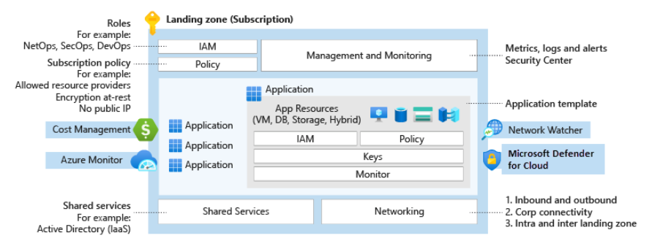
Governance
Azure governance establishes the tooling needed to support cloud governance, compliance auditing, and automated guardrails.
Governance provides mechanisms and processes for maintaining control over platforms, applications, and resources in Azure.
Notes:
Key Message: In Azure, everything is a resource. Management of the resources provisioning should be repeatable, consistent and versioned
Description : The image highlights the functional roles and responsibilities of a Platform DevOps Team.
Resources & Policies are deployed through ARM and centrally stored in the GIT repository seen on the left.
The right side is the automated provisioning, deployment, orchestration and lifecycles of the subscription, roles and policies.
Both together will enable teams to deploy and manage infrastructure through automation
Delineation between DevOps vs AppOps
DevOps – Application team is responsible for managing the full lifecycle of the resources created
AppOps – Some customers don't have not adopted devops and have a dedicated, centralized team to support IT operations on their behalf (E.G Backup, Tuning, Provisioning)
Identify and Access Management
DevOps/App Ops group with Contributor role assigned at RSG level

Slide 48
Governance
Going faster, whilst maintaining control and stability.
Change advisory review boards might hinder an organizations innovation and business agility.
Azure Policy increases workload efficiency by replacing such reviews with automated guardrails and adherence audits.

Slide 49
Governance Design Area
Considerations
Determine what Azure policies are needed based on your business controls or compliance regulations. Use the policies included in the Azure landing zone accelerator as a stating point.
How is the organization’s cost and recharging model structured? What are the key data points required to accurately see cloud services spend? Finding the structure of tags that fits your cost and recharging model might help track your cloud spend.
Azure Cost Management + Billing might help support your ongoing governance cost and spending in Azure, or other multicloud environments.
What are the groups of resources in your environment? These groups can share configuration characteristics that might be required to help stay consistent.
What tools and guardrails need to be enforced across the environment as part of a security baseline? And who might be notified when deviations are found?
Who might have access to audit logs for identity and access management? Who might be notified when suspicious sign-in events occur? Consider using Azure Active Directory reports to govern activity.

Slide 50
Governance Design Area
Recommendations
Identify required Azure tags and use the append policy mode to enforce usage. Use the tagging strategy article as a starting point
Map regulatory and compliance requirements to Azure Policy definitions and Azure role assignments. Establish Azure Policy definitions at the top-level root management group as they might be assigned at inherited scopes.
Use built-in policies to minimize operational overhead.
Manage policy assignments at the highest appropriate level with exclusions at bottom levels, if necessary.
Limit the number of Azure Policy assignments made at the root management group scope to avoid managing through exclusions at inherited scopes.
Use Azure Cost Management + Billing to implement financial oversight on resources in your environment. Use tags in Azure to append metadata to resources, which might enable granular analysis of spend (such as cost center or project name).

Slide 51
Platform Automation & DevOps
Platform automation and DevOps evaluate opportunities to modernize your approach to environmental deployment with infrastructure as code options.
Notes:
Key Message: In Azure, everything is a resource. Management of the resources provisioning should be repeatable, consistent and versioned
Description : The image highlights the functional roles and responsibilities of a Platform DevOps Team.
Resources & Policies are deployed through ARM and centrally stored in the GIT repository seen on the left.
The right side is the automated provisioning, deployment, orchestration and lifecycles of the subscription, roles and policies.
Both together will enable teams to deploy and manage infrastructure through automation
Delineation between DevOps vs AppOps
DevOps – Application team is responsible for managing the full lifecycle of the resources created
AppOps – Some customers don't have not adopted devops and have a dedicated, centralized team to support IT operations on their behalf (E.G Backup, Tuning, Provisioning)
Identify and Access Management
DevOps/App Ops group with Contributor role assigned at RSG level

Slide 52
Platform Automation and DevOps Design Area
Considerations and Recommendations
Concerning central teams, consider using pipelines for continuous integration and continuous deployment.
Pipelines might be used to manage policy and role definitions, policy assignments, management group hierarchies, and subscriptions. These pipelines help ensure that you can operationally manage multiple subscriptions and conform to a desired state.
The blanket application of a DevOps model won't instantly establish capable DevOps teams.
The Azure landing zone accelerator can help integrate continuous integration and continuous deployment (CI/CD) pipelines into the environment using GitHub with GitHub Actions. The portal process guides you through the steps to set up the integration.
By integrating CI/CD pipelines into the environment, platform resources can be managed as code in a repository.

Slide 53
Enterprise-scale Implementation Guide

Slide 54

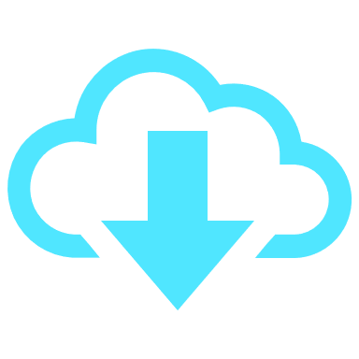
Enterprise-scale Implementation Guide How to get started
To establish an initial configuration
Must be performed by the Azure and AAD admins
Primarily one-off activities
Sequential by nature
What-must-be-true
To instantiate a “landing zone“
Require user input to kickstart the workflow which will coordinate resource creation within AAD and AD
Recurring activities
To operationalize at scale, these activities must follow the principal of "Infrastructure-as-Code" and automate using deployment pipelines.
File → New → Region &
File → New → Landing Zone
Notes:
Key message – let’s discuss how to get started with the Enterprise-Scale platform-native reference implementation and outline design objectives, current design
There are two categories of activities that must take place in order to implement the "North Star" architecture.
What-must-be-true
What-must-be-true for the enterprise-scale architecture: Encompasses activities that must be performed by the Azure and Azure AD administrators to establish an initial configuration. These activities are sequential by nature and primarily one-off activities.
Enable a new region (File -> New -> Region): Set of activities that are required whenever there is a need to expand the enterprise-scale platform into a new Azure region.
Deploy a new landing zone (File -> New -> Landing Zone): These are recurring activities that are required to instantiate a new landing zone.

Slide 55
Enterprise-scale Implementation Guide How to get started
Activities & Policies
AAD Tenants
Management Group & Subscription
Global Networking & Connectivity
Security, Governance & Compliance
Platform Management & Monitoring
What-must-be-true
Activities & Policies
Create new Subscriptions and Regions
Connect and secure all VNets
Protect Vnets across VHubs
Assign owners and Management Groups
Setup budgets, alerts, and security contacts
Create AAD groups
Provision required services
Assign policies
File → New → Region &
File → New → Landing Zone

Slide 56
Enterprise-scale Reference Implementation

Slide 57
The enterprise-scale architecture is modular by design and allow customers to start with foundational landing zones that support their application portfolios, regardless of whether the applications are being migrated or are newly developed and deployed to Azure. The architecture can scale alongside the customer's business requirements regardless of scale point.

Slide 58
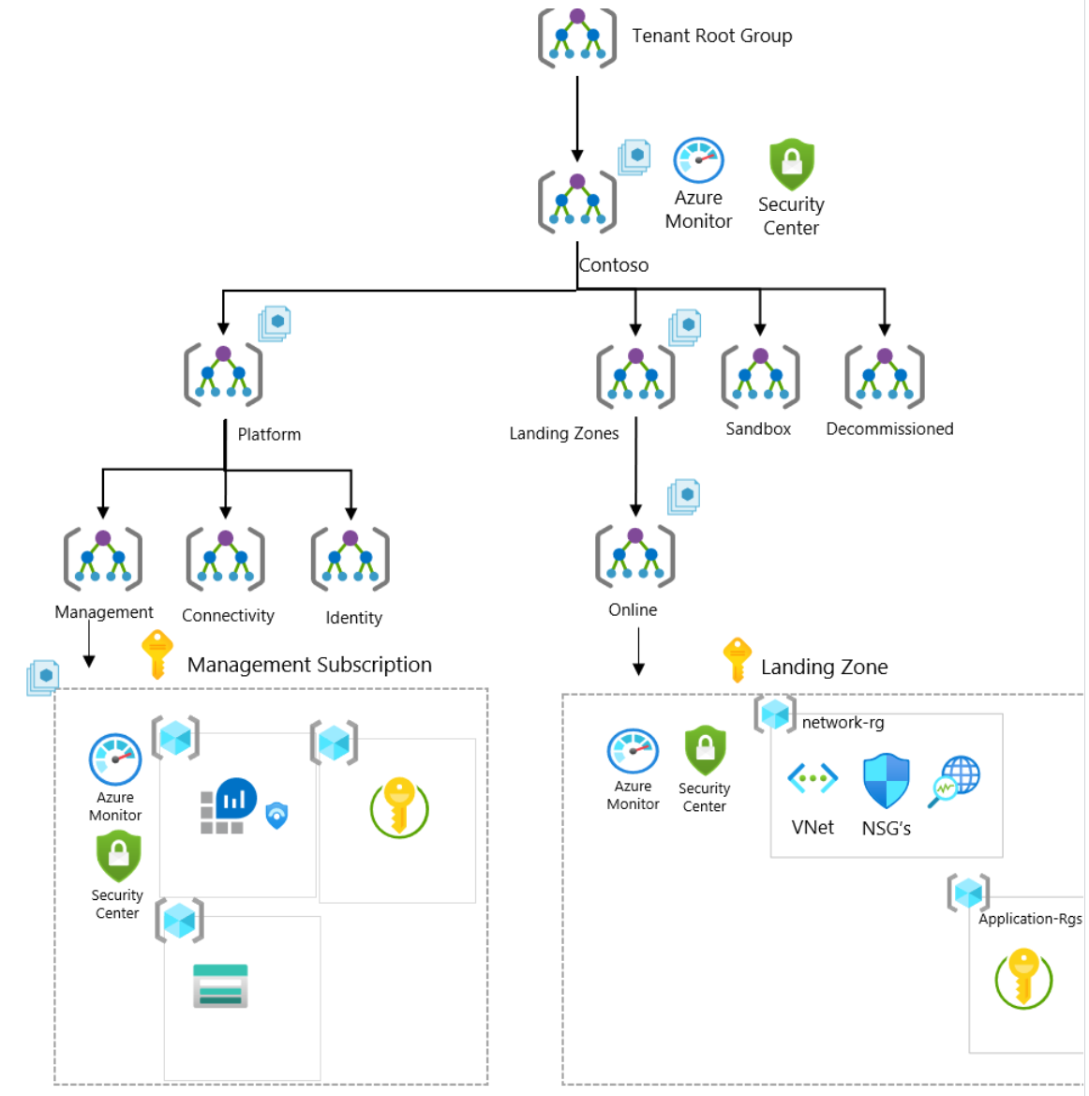
Enterprise-Scale foundation
If the business requirements changes over time, such as migration of on-prem applications to Azure that requires hybrid connectivity, the architecture allows you to expand and implement networking without any refactoring of the architecture nor implications to the runtime state of existing applications. You will simply create the connectivity subscription and place it into the platform management group and assign Azure Policy for the networking topology you desire.
Notes:
Start here with foundations but what if you need to scale , (go to next slide)

Slide 59
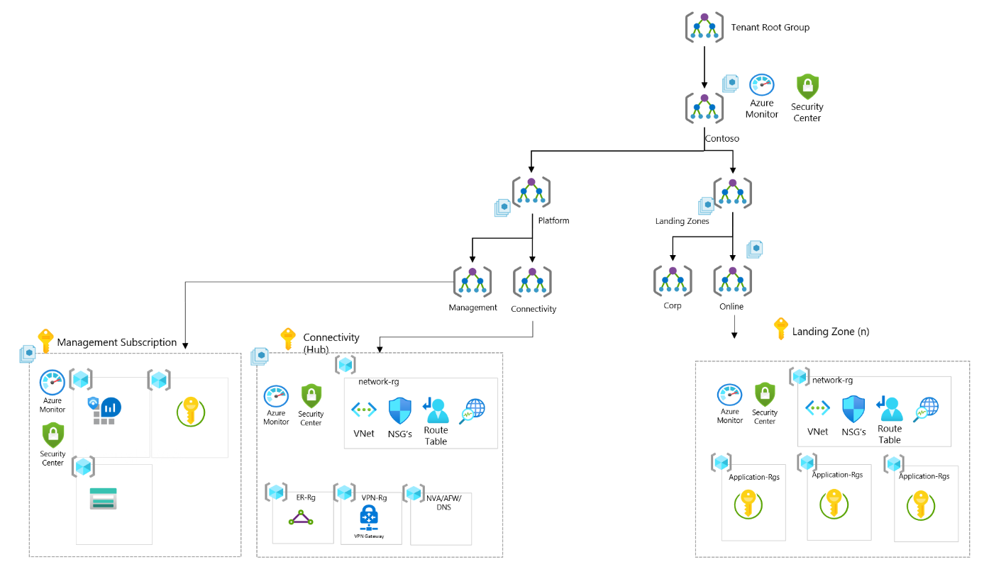
Enterprise-Scale foundation
Enterprise-Scale foundation + Connectivity
If customer started with a Enterprise scale foundation deployment, and if the business requirements changes over time, such as migration of on-prem applications to Azure that requires hybrid connectivity, you will simply create the connectivity subscription and place it into the platform management group and assign Azure Policy for the hub and spoke network topology.
Notes:
This reference implementation is ideal for customers that have started their Enterprise-Scale journey with an Enterprise-Scale foundation implementation and then there is a need to add connectivity on-premises datacenters and branch offices by using Azure VWAN, ExpressRoute and VPN. This reference implementation is also well suited for customers who want to start with Landing Zones for their net new deployment/development in Azure, where a global transit network is required, including hybrid connectivity to on-premises datacenters and branch offices via ExpressRoute and VPN.

Slide 60
Demo
Notes:
Demonstrate Reference Implementation deployment demo

Slide 61
Resources & Next Steps

Slide 62
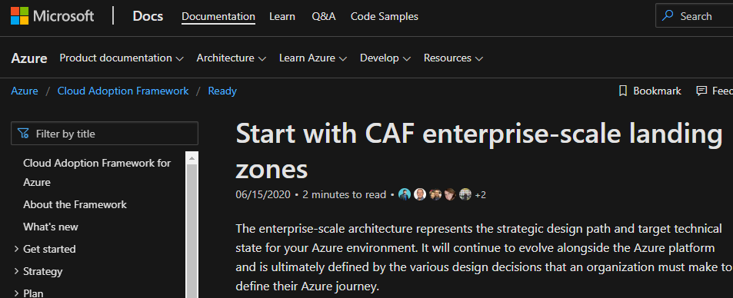
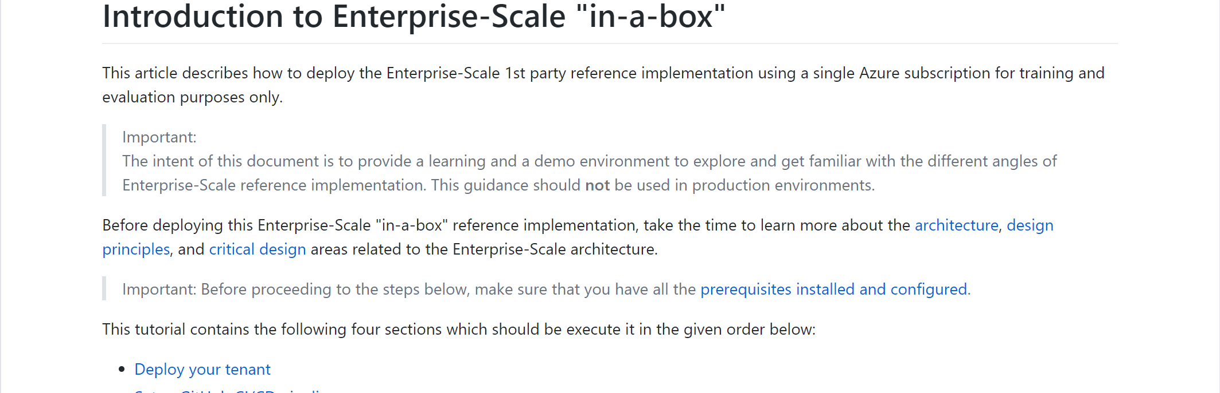
Enterprise-Scale Resources
Solution Complete 👍
Opinionated Architecture & Design Guidelines - Complete
Reference Implementation - Complete
Engineering Signoff - Complete
Enterprise-scale landing zones Architecture guidance and reference implementation:
Introduction to Enterprise-Scale “in-a-box” hands on activity
Ready overview: http://aka.ms/adopt/ready
Download a Visio file that contains Enterprise-scale architecture diagram.
Notes:
WCB Customer Engineering Team (CET)
Will maintain (build tests & track) authoritative guidance and reference implementation. Both will evolve on a regular cadence as new Azure Platform capabilities are released, & validated in production. The reference implementation will be released and updated on a best effort basis.

Slide 63
Next steps
Get ready to deploy guidance on Cloud Adoption Framework
Learn more about the Design Principles for Enterprise-scale
Drill down into the Enterprise-scale Design Guidelines to build your environment
Configure your environment using the reference implementation guide
Leverage the Enterprise-scale landing zones template schema
Let’s get started and build your enterprise-scale landing zone for successful deployment and use of Azure

Slide 64
Thank you!

